Slide 1

IGHG Nephrotoxicity
Surveillance
Esmee Kooijmans
7 July 2022
Notes:
1

Slide 2
Content
Scope
Conclusions of evidence
Translating evidence into recommendations
Draft recommendations
Notes:
2

Slide 3
Scope
Target population
Childhood, adolescent and young adult cancer survivors treated for cancer up to age 25 years ≥ 2 years post-treatment
Outcomes
Glomerular dysfunction
  Decreased glomerular filtration rate
  Proteinuria / albuminuria
Tubular dysfunction
  Electrolyte disturbances
  Tubular proteinuria
Notes:
3

Slide 4
Conclusions of evidence

Slide 5
Who needs surveillance?
 | Glomerular dysfunction
 | Decreased GFR | Proteinuria
Treatment factors
Ifosfamide (y/n) | ⬆⊕⊕⊕⊕ HIGH | ⬆⊕⊕⊕⊕ HIGH
Higher ifosfamide dose | ⬆⊕⊕⊕⊕ HIGH | ⬆⊕⊕⊕⊕ HIGH
Cisplatin (y/n) | ⬆⊕⊕⊕⊕ HIGH | ⬆⊕⊕⊖⊖ LOW
Higher cisplatin dose | ⬆⊕⊕⊕⊕ HIGH | ⬆⊕⊕⊖⊖ LOW
Carboplatin (y/n) | ⬆⊕⊕⊕⊖ MODERATE | ⬆⊕⊕⊖⊖ LOW
Higher carboplatin dose | ⬆⊕⊕⊖⊖ LOW | =⊕⊕⊕⊖ MODERATE
Methotrexate( (MTX) y/n) | =⊕⊕⊕⊕ HIGH | =⊕⊕⊕⊕ HIGH
Higher MTX dose | =⊕⊕⊕⊕ HIGH | =⊕⊕⊕⊖ MODERATE
MTX administration routes | No studies | No studies
Nitrosoureas (y/n) | No studies | No studies
Higher nitrosoureas dose | No studies | No studies
Melphalan (y/n) | No studies | No studies
Higher melphalan dose | No studies | No studies
Cyclophosphamide (y/n) | =⊕⊕⊖⊖ LOW | =⊕⊕⊕⊕ HIGH
Higher cyclophosphamide dose | =⊕⊖⊖⊖ VERY LOW | =⊕⊖⊖⊖ VERY LOW
Radiotherapy (RT) renal area (y/n) | ⬆⊕⊕⊕⊕ HIGH | =⊕⊕⊕⊕ HIGH
Higher RT dose | ⬆⊕⊕⊕⊖ MODERATE | =⊕⊕⊖⊖ LOW
RT one vs. both kidneys | No studies | No studies
RT actual portion kidney | ⬆⊕⊕⊖⊖ LOW* | =⊕⊕⊖⊖ LOW
Total body irradiation (y/n) | ⬆⊕⊕⊕⊖ MODERATE | ⬆⊕⊕⊖⊖ LOW
Nephrectomy (y/n) | ⬆⊕⊕⊕⊕ HIGH | ⬆⊕⊕⊖⊖ LOW
Nephrectomy uni vs. partial bilateral | No studies | No studies
Hematopoietic stem cell transplantation (y/n) | =⊕⊖⊖⊖ VERY LOW | No studies

Slide 6
Start and frequency of surveillance
When should surveillance be initiated?
The course of renal dysfunction in CAYA cancer survivors diagnosed up to 25 years of age
Glomerular dysfunction |  | Quality of evidence
Progressive decrease of GFR that parallels the physiological decline of GFR also seen in healthy subjects or CCS without nephrotoxic therapy. However, they have a decreased mean GFR compared to controls (range follow-up 1st – 5th decade) |  | ⊕⊕⊕⊕ HIGH
Risk for renal dysfunction after acute renal toxicity episode in CAYA cancer survivors diagnosed up to 25 years of age
Glomerular dysfunction | Outcome | Quality of evidence
1. eGFR <60 vs. >60 ml/min/1.73m² at the time of childhood cancer diagnosis 2. having a history of ≥ 4 AKI episodes vs. no AKI episodes during cancer treatment | Increased risk (decreased GFR) | ⊕⊖⊖⊖ VERY LOW
Predictors for change of risk over time
 | Glomerular dysfunction | Remarks
Treatment predictors
Ifosfamide | =⊕⊕⊕⊖ MODERATE
Cisplatin | ⬆⊕⊕⊕⊖ MODERATE* | *More rapid deterioration rate of GFR after higher vs. lower cisplatin dose up to 25 years after diagnosis
Carboplatin | =⊕⊕⊕⊖ MODERATE
HD-methotrexate* | =⊕⊕⊕⊕ HIGH | * > 5g/m²
HD-cyclo* | ⬆⊕⊕⊖⊖ LOW** | * ≥1 g/m²/course or a total cumulative dose of ≥10 g/m² ** Modest differences in rate of GFR deterioration after HD- vs. non-HD-cyclophosphamide
RT renal area | =⊕⊕⊖⊖ LOW
TBI | ⬆⊕⊕⊖⊖ LOW* | * Higher deterioration rate of GFR after TBI vs. no TBI
Nephrectomy | =⊕⊕⊖⊖ LOW
Type of HSCT | =⊕⊖⊖⊖ VERY LOW
Host predictors
Age | See below
Nephrectomy age | ⬆⊕⊕⊖⊖ LOW* | *Faster decline in GFR after nephrectomy at older vs. younger age

Slide 7
Who needs surveillance?
 | Tubular dysfunction | Combined glomerular & tubular dysfunction
Treatment factors
Ifosfamide (y/n) | ⬆⊕⊕⊕⊕ HIGH | ⬆⊕⊕⊖⊖ LOW
Higher ifosfamide dose | ⬆⊕⊕⊕⊖ MODERATE | ⬆⊕⊕⊖⊖ LOW
Cisplatin (y/n) | ⬆⊕⊕⊕⊖ MODERATE | =⊕⊕⊖⊖ LOW
Higher cisplatin dose | ⬆⊕⊕⊖⊖ LOW | =⊕⊕⊖⊖ LOW
Carboplatin (y/n) | ⬆⊕⊖⊖⊖ VERY LOW | No studies
Higher carboplatin dose | ⬆⊕⊕⊖⊖ LOW | ⬆⊕⊖⊖⊖ VERY LOW
MTX (y/n) | =⊕⊕⊕⊖ MODERATE | No studies
Higher MTX dose | =⊕⊕⊖⊖ LOW | No studies
MTX administration routes | No studies | No studies
Nitrosoureas (y/n) | No studies | No studies
Higher nitrosoureas dose | No studies | No studies
Melphalan (y/n) | No studies | No studies
Higher melphalan dose | No studies | No studies
Cyclophosphamide (y/n) | =⊕⊕⊕⊖ MODERATE | No studies
Higher cyclophosphamide dose | =⊕⊕⊕⊖ MODERATE | No studies
RT renal area (y/n) | =⊕⊕⊖⊖ LOW | No studies
Higher RT dose | No studies | No studies
RT one vs. both kidneys | No studies | No studies
RT actual portion kidney | No studies | No studies
TBI (y/n) | =⊕⊕⊖⊖ LOW | No studies
Nephrectomy (y/n) | =⊕⊖⊖⊖ VERY LOW | No studies
Nephrectomy uni vs. partial bilateral | No studies | No studies
HSCT (y/n) | No studies | No studies

Slide 8
Start and frequency of surveillance
When should surveillance be initiated?
The course of renal dysfunction in CAYA cancer survivors diagnosed up to 25 years of age
Tubular dysfunction |  | Quality of evidence
After ifosfamide exposure, the risk of tubular dysfunction increases over time until at least 3 years following therapy |  | ⊕⊕⊖⊖ LOW
Risk for renal dysfunction after acute renal toxicity episode in CAYA cancer survivors diagnosed up to 25 years of age
Tubular function | Outcome | Quality of evidence
 | Unknown | No studies
At what frequency should surveillance be performed?
Risk over time of renal dysfunction in CAYA cancer survivors diagnosed up to 25 years of age
 | Tubular dysfunction
Treatment | Outcome | Quality of evidence | Remarks
Ifosfamide | Improvement hypophosphatemia, hypokalemia, abnormal bicarbonate levels* | ⊕⊕⊖⊖ LOW | *The need for supplementation of phosphate and potassium decreases over time and may no longer be needed at 10 years after ifosfamide treatment High ifosfamide dose associated with smaller falls in phosphate and bicarbonate at 10 years compared to 1 year after cancer treatment
Platinum therapy | Stable hypomagnesemia* | ⊕⊕⊖⊖ LOW | *Occurs at low levels 1 year after platinum therapy and remains stable up to at least 3 years
Nephrectomy | Unknown | No studies
NSS | Unknown | No studies
Nephrectomy or NSS with pre-operative renal disease | Unknown | No studies
HSCT | Unknown | No studies
Other treatment modalities | Unknown | No studies

Slide 9
Translating evidence into recommendations

Slide 10
Anticipated desirable effects of surveillance
Guideline | Recommendation | Strength | Level of evidence
KDIGO 2012 | We recommend using serum creatinine and a GFR estimating equation for initial assessment | Strong | High
 | We recommend that clinicians: use a GFR estimating equation to derive GFR from serum creatinine (eGFRcreat) rather than relying on the serum creatinine concentration alone. understand clinical settings in which eGFRcreat is less accurate. | Strong | Moderate
 | We recommend that clinical laboratories should measure serum creatinine using a specific assay with calibration traceable to the international standard reference materials and minimal bias compared to isotope-dilution mass spectrometry (IDMS) reference methodology. | Strong | Moderate
 | We recommend that clinical laboratories should report eGFRcreat in adults using the 2009 CKD-EPI creatinine equation. An alternative creatinine-based GFR estimating equation is acceptable if it has been shown to improve accuracy of GFR estimates compared to the 2009 CKD-EPI creatinine equation. | Strong | Moderate
 | If cystatin C is measured, we suggest that health professionals: use a GFR estimating equation to derive GFR from serum cystatin C rather than relying on the serum cystatin C concentration alone. understand clinical settings in which eGFRcys and eGFRcreat-cys are less accurate. | Moderate | Low
 | We suggest using additional tests (such as cystatin C or a clearance measurement) for confirmatory testing in specific circumstances when eGFR based on serum creatinine is less accurate. | Moderate | Moderate
 | We suggest measuring cystatin C in adults with eGFRcreat 45-59 ml/min/1.73 m² who do not have markers of kidney damage if confirmation of CKD is required. If eGFRcys/eGFRcreat-cys is also <60 ml/min/1.73 m², the diagnosis of CKD is confirmed. If eGFRcys/eGFRcreat-cys is ≥60 ml/min/1.73 m², the diagnosis of CKD is not confirmed. | Moderate | Low
 | We recommend that clinical laboratories that measure cystatin C should measure serum cystatin C using an assay with calibration traceable to the international standard reference material. | Strong | Moderate
 | We recommend that clinical laboratories that measure cystatin C should report eGFRcys and eGFRcreat-cys in adults using the 2012 CKD-EPI cystatin C and 2012 CKD-EPI creatinine-cystatin C equations, respectively, or alternative cystatin C-based GFR estimating equations if they have been shown to improve accuracy of GFR estimates compared to the 2012 CKD-EPI cystatin C and 2012 CKD-EPI creatinine-cystatin C equations. | Strong | Moderate
 | We suggest measuring GFR using an exogenous filtration marker under circumstances where more accurate ascertainment of GFR will impact on treatment decisions. | Moderate | Moderate
SIGN 2008 | Where an assessment of GFR is required prediction equations should be used in preference to 24-hour urine creatinine clearance or serum creatinine alone. | Not graded | Low
CARI 2012 | CKD screening should include both a urine test for albuminuria and a blood test for serum creatinine to determine an eGFR. | Strong | Low
CKD UK 2006 | There is no need to collect 24 hour urine samples to measure creatinine clearance in primary care. | Not graded | Moderate
 | Kidney function in patients with CKD should be assessed by formula-based estimation of GFR, preferably using the 4-variable Modification of Diet in Renal Disease (MDRD) equation: GFR (mL/min/1.73m2) = 186 x {[serum creatinine (μmol/L)/88.4] -1.154} x age (years) - 0.203 x 0.742 if female and x 1.21 if African American. | Not graded | Moderate
 | The same criteria should be used for assessment of kidney function in older people as in younger people. “Age-adjusted” reference ranges for GFR are not recommended. | Not graded | Moderate
ESC/ESH 2018 | Serum-creatinine, eGFR and urine albumin/creatinine ratio should be measured in all hypertensive patients | Strong | Moderate
Delgado 2021 | For US adults (.85% of whom have normal kidney function), we recommend immediate implementation of the CKD-EPI creatinine equation refit without the race variable in all laboratories in the United States | Not graded | Not graded
 | We recommend national efforts to facilitate increased, routine, and timely use of cystatin C, especially to confirm eGFR in adults who are at risk for or have CKD, because combining filtration markers (creatinine and cystatin C) is more accurate and would support better clinical decisions than either marker alone. If ongoing evidence supports acceptable performance, the CKD-EPI eGFR–cystatin C (eGFRcys) and eGFR creatinine–cystatin C (eGFRcr-cys_R) refit without the race variables should be adopted to provide another first-line test, in addition to confirmatory testing. | Not graded | Not graded

Slide 11
Anticipated desirable effects of surveillance
Measurement of serum creatinine, cystatin C, electrolytes and a urine sample is considered as being non-invasive (expert opinion).
CAYA cancer survivors undergoing surveillance are more likely to have kidney dysfunction detected at an earlier timepoint with the potential for better outcomes (i.e. improved survival and quality of life and decreased mortality and morbidity) than CAYA cancer survivors not undergoing surveillance (no evidence).
Referral to a nephrologist may be beneficial for further evaluation, interpretation, treatment, and follow-up (expert opinion).
In children and adults from the general population with hypertension and CKD or hypertension and proteinuria, treatment with ACEi or ARB and strict blood pressure control slows CKD progression and reduces proteinuria, although in CAYA cancer survivors evidence is lacking to support these benefits (evidence based guidelines).
In children and adults from the general population with CKD routine performance of ABPM is of added value to assess hypertension and screen for white coat hypertension and masked hypertension, although in CAYA cancer survivors evidence is lacking to support these benefits (evidence based guidelines).

Slide 12
Anticipated undesirable effects of surveillance
Nephrotoxicity surveillance may increase the risk of misdiagnosis, overdiagnosis, and overtreatment (i.e. incorrect diagnosis of electrolyte disturbances, or identification of electrolyte disturbances that would never lead to a symptoms, possibly resulting in unnecessary treatment with, for example, electrolyte supplementation, which may lead to side-effects) (expert opinion).
Undergoing surveillance might result in fear and anxiety for patients (although the stress and anxiety generally resolve post screening) and the self-perception of being a patient versus healthy (expert opinion).
CAYA cancer survivors may experience pain during blood draws (expert opinion).
CAYA cancer survivors might be falsely reassured that they do not have an increased kidney dysfunction risk when their kidney function test is normal (expert opinion).

Slide 13
Thanks to
Chairs:
Rod Skinner
Matt Ehrhardt
Coordinator:
Esmee Kooijmans
Advisors:
Renée Mulder
Leontien Kremer
Melissa Hudson
Sandy Constine
Hamish Wallace
WG leaders:
Jarmilla Kurseova
Nick Larkins
Tom Walwyn
Stephen Marks
Vesna Pavasovic
Shveta Motwani
WG members:
Heleen van der Pal
Charlotte Demoor
Dan Green
Kathleen Kieran
Kerri Becktell
Joel Thompson
Denitza Mironova
Marry van den Heuvel-Eibrink
Elvira van Dalen
Marika Grönroos
Monica Terenziani
Arend Bökenkamp
Lars Hjorth
Liv Andres-Jensen
Edit Bardi
Songul Onder
Jakub Zieg
Margreet Veening
Ali Mirza Onder
Jonathan Routh
Notes:
13

Slide 14
IGHG Neurocognition
Surveillance
Kevin Krull
7 July 2022
Notes:
14

Slide 15
Content
Clinical questions
Survivor characteristics and outcomes
Selected literature
Discussion of important issues
Notes:
15

Slide 16
Content
Clinical questions
Survivor characteristics and outcomes
Selected literature
Discussion of important issues
Notes:
16

Slide 17
Clinical Questions
Who needs surveillance?
What surveillance modality should be used?
At what age or time from exposure should surveillance be performed?
At what frequency should surveillance be performed?
When should surveillance be stopped?
What should be done when abnormalities are identified?

Slide 18
Working Groups
WG1: Who needs surveillance?
WG2: What surveillance modality should be used?
WG3: At what age or time from exposure should surveillance be performed? At what frequency should surveillance be performed? When should surveillance be stopped?
WG4: What should be done when abnormalities are identified?

Slide 19
WG1: Who Needs Surveillance?
Risks and risk factors
Cancer diagnoses
Cranial radiotherapy
  Dose
  Volume of exposure
  Energy source
Chemotherapy
  Cytarabine
  Methotrexate
  others
Neurosurgery
  Location
  Number of surgeries
  Associated factors
Hematopoietic stem cell transplant
  Conditioning regimen
Comorbid medical conditions
Age, sex, SES

Slide 20
WG2: Surveillance Modality
Screening tools
Prognostic value
  Sensitivity - specificity
Feasibility, accessibility
Use of school-based performance
Standard evaluations
Validated measures
Applicable populations
Computer vs. examiner administered
Performance-based vs. PRO’s

Slide 21
WG3: Timing of Surveillance
When should surveillance begin?
How often should surveillance occur?
When should surveillance be stopped?
What is the latency time to develop neurocognitive deficits?
Does the risk of developing neurocognitive deficits change over time?

Slide 22
WG4: Follow-up on Surveillance
What are possible interventions?
Effectiveness of these interventions?
Feasibility and scalability of these interventions?
Can we predict who benefits from which intervention?
Are benefits maintained?
Do benefits generalize?
What is the optimal timing and dose of interventions?

Slide 23
Content
Clinical questions
Survivor characteristics and outcomes
Notes:
23

Slide 24
Characteristics and Outcomes
Target population
Childhood, adolescent and young adult cancer survivors
At least 75% diagnosed with cancer prior to 25 years of age
100% at the end of treatment, but can include during treatment
At least 50% assessed 2 years post-treatment
Outcomes
IQ, attention, memory, processing speed, visual-motor integration, fine motor skills, executive functions, language, academic abilities
Notes:
24

Slide 25
Content
Clinical questions
Survivor characteristics and outcomes
Selected evidence
Notes:
25

Slide 26
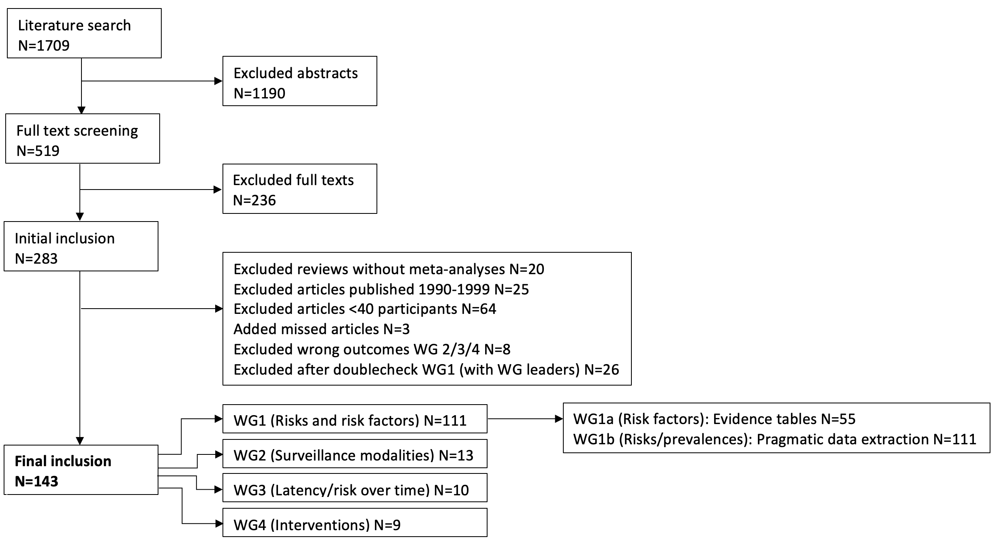
Included studies
Overview selected evidence for the WGs
Notes:
26

Slide 27
Content
Clinical questions
Survivor characteristics and outcomes
Selected evidence
Discussion of important issues
Notes:
27

Slide 28
Discussion
Amount of selected evidence
  Number of manuscripts
  Number of tests within each manuscripts
  Number of variables within each test
Interpretation of neurocognitive test results
  Measures used to identify construct
  Scales used for data classification
    Continuous vs dichotomous
    Threshold for impairment
Variability in cognitive domains assessed

Slide 29
Thanks to
Chairs:
Kevin Krull
Sophie Thomas
Coordinators:
Eva Hooft van Huijsduijnen
Charlotte Sleurs (until August ‘22)
Chiara Papini (from August ‘22)
Advisors:
Renée Mulder
Elvira van Dalen
Melissa Hudson
Leontien Kremer
Roderick Skinner
Martha Grootenhuis
Louis Constine
WG leaders:
Ellen van der Plas
Jurgen Lemiere
Chris Halsey
Alicia Kunin-Batson
WG members:
Anita Mahajan
Cecilia Follin
Johanna Blom
Daniel Bowers
Ingrid Tonning Olsson
Femke Aarsen
Karin Walsh
Netteke Schouten-van Meeteren
Joshua Palmer
Arja Harila-Saari
Noah Sabin
Donald Mabbott
Zsila Sadighi
Gauri Kapoor
Monika Kapitancuke
Pia Banerjee
Stephen Sands
Lisa Kahalley
Leanne Embry
Kim Bull
Marita Partanen
Lisa Jacola
Anne Neumann-Holbeck
Kristina Hardy
Heather Conklin
Susanna Waern
Notes:
29

Slide 30
IGHG: Safety of growth hormone treatment in children with cancer
7 July 2022
Hanneke van Santen, Pediatric Endocrinologist
Notes:
30

Slide 31
Content
Background
Expert Team
Scope and Definitions
Clinical questions
Selected evidence
Next steps
Notes:
31

Slide 32
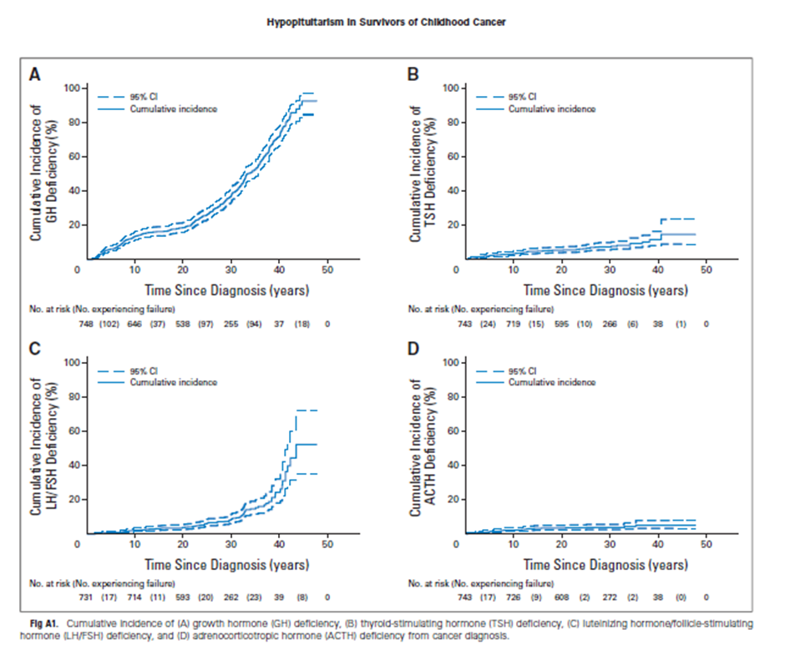

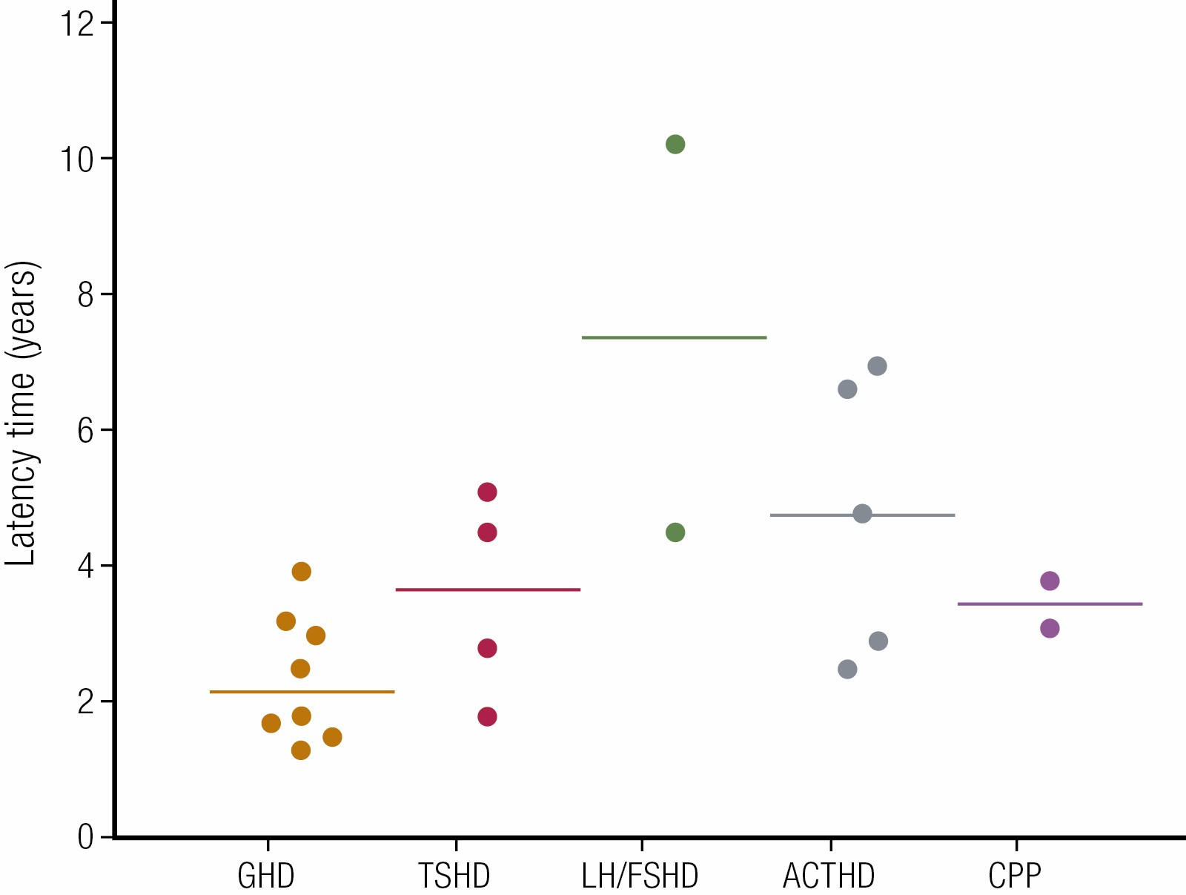
Background
Pituitary dysfunction is frequent in CAYA survivors
GHD most common
Notes:
32

Slide 33

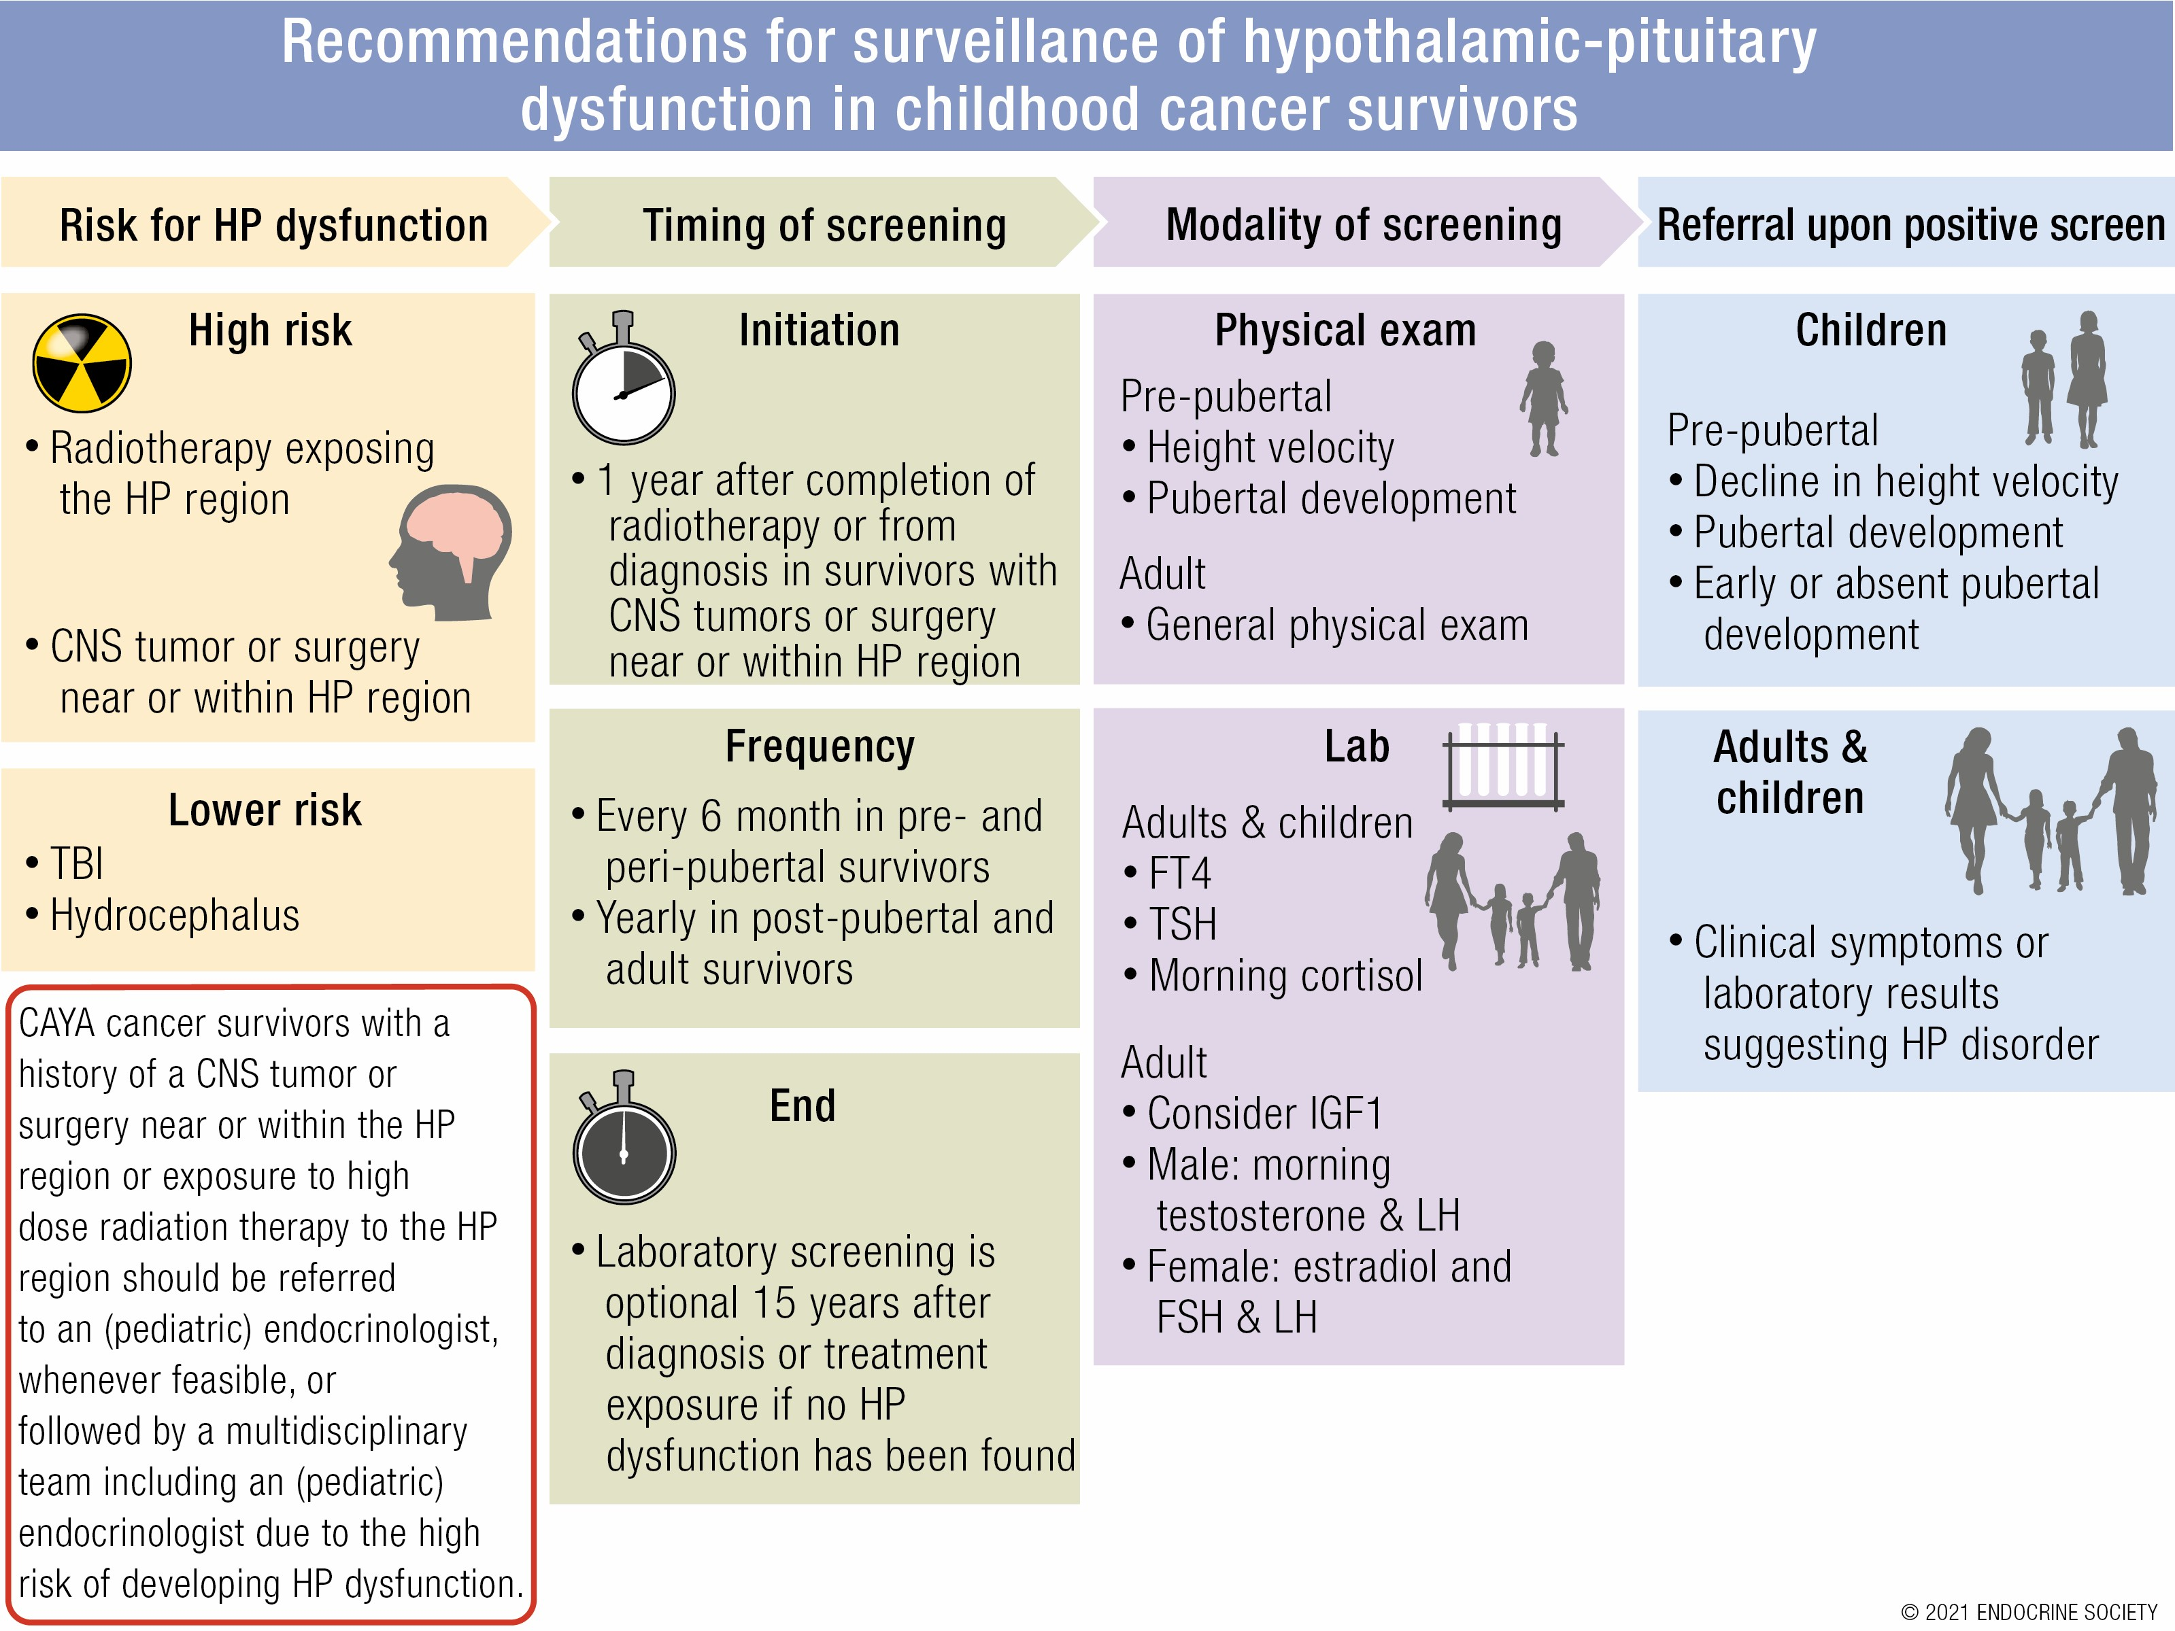
Background
Hypothalamic-Pituitary and Other Endocrine Surveillance Among Childhood Cancer Survivors
Laura van Iersel, Renee L Mulder, Christian Denzer, Laurie E Cohen, Helen A Spoudeas, Lillian R Meacham, Elaine Sugden, Antoinette Y N Schouten-van Meeteren, Eelco W Hoving, Roger J Packer, Gregory T Armstrong, Sogol Mostoufi-Moab, Aline M Stades, Dannis van Vuurden, Geert O Janssens, Cécile Thomas-Teinturier, Robert D Murray, Natascia Di Iorgi, Sebastian J C M M Neggers, Joel Thompson, Andrew A Toogood, Helena Gleeson, Cecilia Follin, Edit Bardi, Lilibeth Torno, Briana Patterson, Vera Morsellino, Grit Sommer, Sarah C Clement, Deokumar Srivastava, Cecilie E Kiserud, Alberto Fernandez, Katrin Scheinemann, Sripriya Raman, Kevin C J Yuen, W Hamish Wallace, Louis S Constine, Roderick Skinner, Melissa M Hudson, Leontien C M Kremer, Wassim Chemaitilly, Hanneke M van Santen
Endocrine Reviews, 20 November 2021
next step
Notes:
33

Slide 34
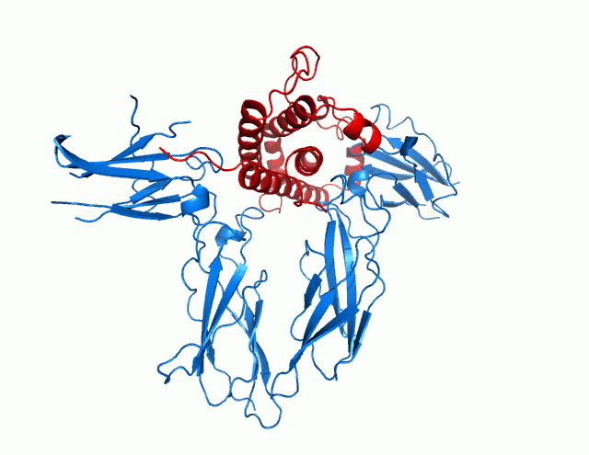
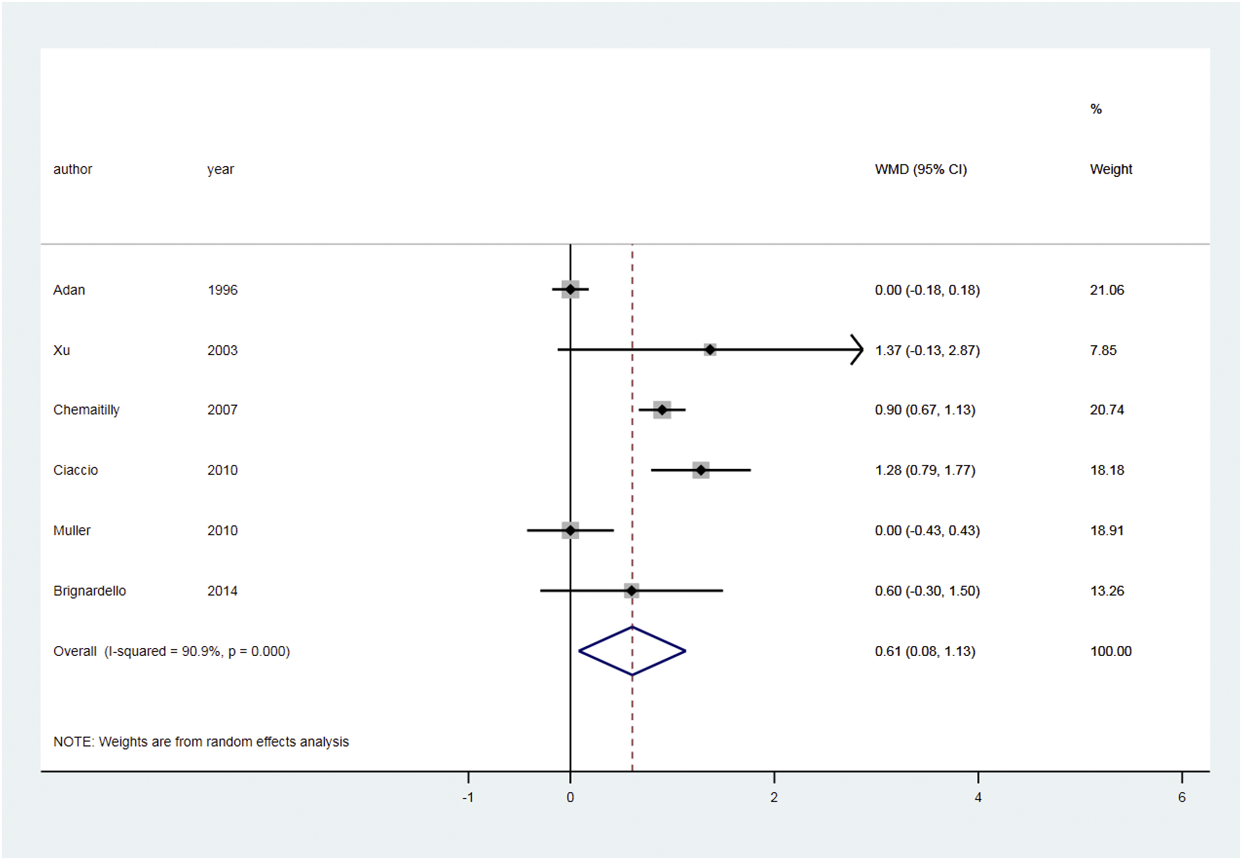
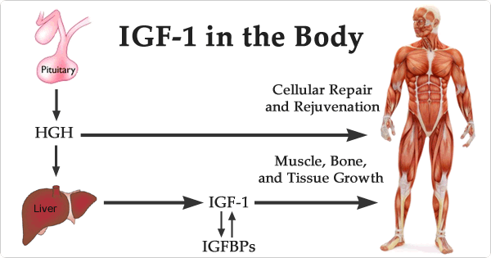
After surveillance; treatment with GH?
Benefits of GH in CCS versus possible risks
Metabolic state
Lineair growth
Notes:
34

Slide 35
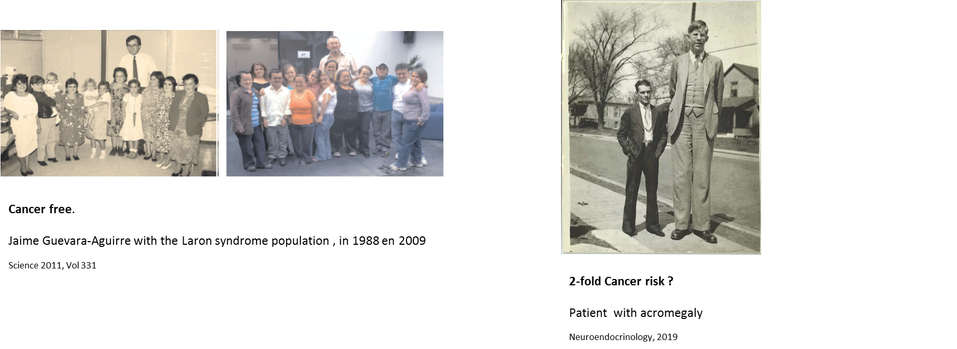
GH safe in CCS?
Concerns have been raised regarding GHRT and cancer risk
Notes:
35

Slide 36
2018 Endocrine Society
GH replacement in cancer survivors should be managed in a manner similar to GH replacement in other populations
Wait to initiate GH treatment until patients are “disease free” for 1 year
Recommend maintaining normal growth factor levels
Consider dose reduction if IGF-1 SD > + 2
Some pediatric cancer patients, may never be “disease free.” Collaboration with the oncologist is necessary to ascertain the benefits versus the harms of commencing GH therapy in such cases.
Sklar et al. Hypothalamic-Pituitary and Growth Disorders in Survivors of Childhood Cancer: An Endocrine Society Clinical Practice Guideline. JCEM 2018
Notes:
36

Slide 37

Start GH IGHG Recommendation
Jan 2021
Chairs:
Hanneke van Santen
Wassim Chemaitilly
Simon Bailey
Coordinator:
Jiska van Schaik
Advisors:
Leontien Kremer, Renee Mulder, Laura van Iersel, Rod Skinner, Melissa Hudson
WG leaders:
Lillian Meacham, Sogol Mostoufi-Moab, Laurie Cohen
WG members:
Angela Delaney Freedman, Boudewijn Bakker, Hoong Wei Gan, Briana Patterson, Alberto Fernandez, Lisethe Meijer, Netteke Schouten-van Meeteren, Jonathan Wasserman, Pablo Herniaz, Stephanie Smetsers, Gudmundur Johannsson, Deo Kumar Srivastava, Cecilie Kiserud, Katrin Scheinemann, Lars Savendahl, Greg Armstrong, Zoltan Altan, Jennifer Abuzzahab, Christian Denzer, Ulrich Paetow, Nathalie Alos, Maya Lodish, Maura Massimino, Peter Clayton, Anita Hokken-Koelega, Roger Packer, Junne Kamihara, Gerhard Binder, Mike Walsh, Margaret Boguszewski
Notes:
37

Slide 38
Scope and definitions
Aim and target population
To define a recommendation upon the use of growth hormone (GH) in children at risk for, during or after treatment for childhood cancer with regards to cancer risk.
Clinical outcomes
Tumor progression, tumor recurrence, mortality, and morbidity in relation to growth hormone treatment
Notes:
38

Slide 39
Working Groups
WG1: GH safety in low grade neoplasms
WG2: GH safety in high grade neoplasms
WG3: GH safety in childhood predisposition syndromes
Notes:
39

Slide 40

2022 Growth Research Society
Experts, 3 meetings, consensus statement
Current evidence reviewed from the proceedings from the Workshop does not support an association between GH replacement and primary tumour or cancer recurrence.
The effect of GH replacement on secondary neoplasia risk is minor compared to host and tumor treatment-related factors.
In children with cancer predisposition syndromes, GH treatment is generally contraindicated, but may be considered cautiously in select patients.
There are no data justifying an absolute contraindication for GH replacement in GH-deficient patients with a strong family history of cancer; each case needs to be considered individually.
Discuss the individual benefits and possible harms with each patient and the parents. Child vs adult.
Boguszewski MCS, Boguszewski CL, Chemaililly W, Cohen LE, Gebauer J, Higham C, Hoffman AR, Polak M, Yuen KCJ, Alos N, Antal Z, Bidlingmaier M, Biller BMK, Brabant G, Choong CSY, Cianfarani S, Clayton PE, Coutant R, Cardoso-Demartini AA, Fernandez A, Grimberg A, Guðmundsson K, Guevara-Aguirre J, Ho KKY, Horikawa R, Isidori AM, Jørgensen JOL, Kamenicky P, Karavitaki N, Kopchick JJ, Lodish M, Luo X, McCormack AI, Meacham L, Melmed S, Mostoufi Moab S, Müller HL, Neggers SJCMM, Aguiar Oliveira MH, Ozono K, Pennisi PA, Popovic V, Radovick S, Savendahl L, Touraine P, van Santen HM, Johannsson G.
Boguszewski MCS et al, Eur J Endocrinol, 2022
Notes:
40

Slide 41
Steps of the IGHG recommendation
Step 1: Evaluate concordances and discordances of current recommendations
Step 2: Formulate clinical questions
Step 3: Identify and select the evidence
Step 4: Making the evidence tables
Step 5: Summarize and appraise quality of evidence
Step 6: Formulate recommendations
Jan 21
Jan 23

Slide 42
Clinical questions

Slide 43
Clinical questions WG 1: low grade
1. In a child/YA with (a history of) a low grade CNS neoplasm, what is the effect of growth hormone treatment (GHT) on: tumor progression, tumor recurrence, mortality, and morbidity?
2. In a child/YA with (a history of) a low grade non-CNS neoplasm, what is the effect of growth hormone treatment (GHT) on: tumor progression, tumor recurrence, mortality, and morbidity?
3. In a child/YA with (a history of) a low grade CNS neoplasm (during chronic therapy, such as: targeted therapy (MEK inhibitors), what is the effect of growth hormone treatment (GHT) on: tumor progression, tumor recurrence, mortality, and morbidity?
4. In a child/YA with (a history of) a low grade neoplasm (CNS and non-CNS), what is the effect of timing of GHT on: tumor progression, tumor recurrence, mortality, and morbidity?
5. In a child/YA with (a history of) a low grade neoplasm (CNS and non-CNS), what is the effect of GH dose/ IGF-1 level on: tumor progression, tumor recurrence, mortality, and morbidity?
6. In a child/YA with (a history of) a low grade neoplasm (CNS and non-CNS), are there any risk factors (such as age, gender, tumor biology/pathology, radiation exposure, chemotherapy) that alter the risk for the effect of GH on: tumor progression, tumor recurrence, mortality, and morbidity?

Slide 44
Clinical questions WG 2: high grade
1. In a child/YA with (a history of) a high grade CNS neoplasm, what is the effect of growth hormone treatment (GHT) on: tumor progression, tumor recurrence, mortality, and morbidity?
2. In a child/YA with (a history of) a high grade non-CNS neoplasm, what is the effect of growth hormone treatment (GHT) on:tumor progression, tumor recurrence, mortality, and morbidity?
3. In a child/YA with (a history of) a high grade neoplasm on chronic therapy (such as: targeted therapy (MEK inhibitors), what is the effect of growth hormone treatment (GHT) on: tumor progression, tumor recurrence, mortality, and morbidity?
4. In a child/YA with (a history of) a high grade neoplasm (CNS and non-CNS), what is the effect of timing of GHT on: tumor progression, tumor recurrence, mortality, and morbidity?
5. In a child/YA with (a history of)a high grade neoplasm (CNS and non-CNS), what is the effect of GH dose/ IGF-1 level on: tumor progression, tumor recurrence, mortality, and morbidity?
6. In a child/YA with (a history of) a high grade neoplasm (CNS and non-CNS) and allogeneic hematopoietic stem cell transplantation with or without TBI, what is the effect of GHT on: tumor progression, tumor recurrence, mortality, and morbidity?
7. In a child/YA with (a history of) a high grade neoplasm (CNS and non-CNS), are there any risk factors (such as age, gender, tumor biology/histology, radiation exposure, chemotherapy) that alter the risk for the effect of GH on: tumor progression, tumor recurrence, mortality, and morbidity?

Slide 45
Clinical questions WG 3: predisposition syndromes.
1. In a child/YA with a cancer predisposition syndrome, not GH deficient, what is the effect of growth hormone treatment (GHT) on: cancer occurence, tumor progression, tumor recurrence, mortality, and morbidity?
2. In a child/YA with a cancer predisposition syndrome, and GH deficient, what is the effect of growth hormone treatment (GHT) on: cancer occurrence, tumor progression, tumor recurrence, mortality, and morbidity?
3. In a child/YA with a cancer predisposition syndrome, is there an effect of GH dose/ IG-1 level and: cancer occurence, tumor progression, tumor recurrence, mortality, and morbidity?
4. In a child/YA with a cancer predisposition syndrome, is there an effect of timing of GH treatment and: tumor progression, tumor recurrence, mortality, and morbidity?

Slide 46
Selected evidence

Slide 47
Title/abstract selection: low and high grade

Slide 48
Title/abstract selection: predisposition syndromes

Slide 49
Next steps

Slide 50
Making the evidence tables

Slide 51
Making the summary tables
… in progression
Next steps:
Conclusions of the evidence
Translating the evidence into recommendations

Slide 52

Thanks to
Chairs:
Hanneke van Santen
Wassim Chemaitilly
Simon Bailey
Coordinator:
Jiska van Schaik
Advisors:
Leontien Kremer, Renee Mulder, Laura van Iersel, Rod Skinner, Melissa Hudson
WG leaders:
Lillian Meacham, Sogol Mostoufi-Moab, Laurie Cohen
WG members:
Angela Delaney Freedman, Boudewijn Bakker, Hoong Wei Gan, Briana Patterson, Alberto Fernandez, Lisethe Meijer, Netteke Schouten-van Meeteren, Jonathan Wasserman, Pablo Herniaz, Stephanie Smetsers, Gudmundur Johannsson, Deo Kumar Srivastava, Cecilie Kiserud, Katrin Scheinemann, Lars Savendahl, Greg Armstrong, Zoltan Altan, Jennifer Abuzzahab, Christian Denzer, Ulrich Paetow, Nathalie Alos, Maya Lodish, Maura Massimino, Peter Clayton, Anita Hokken-Koelega, Roger Packer, Junne Kamihara, Gerhard Binder, Mike Walsh, Margaret Boguszewski
Notes:
52

Slide 53
IGHG Recommendations on Surveillance for Pulmonary Dysfunction
Maria Otth, MD PhD
7 July 2022
Kasteler R., Mulder RL, Agrusa J, Armenian S, Barnea D, Berger C, Bergeron-Lafaurie A, Bhatt N, Bourke S, Castagnola E, Constine S, Demoor-Goldschmidt C, Goutaki M, Green D, Hennewig U, Houdouin V, Hudson M, Kremer L, Latzin P, Ng A, Oeffinger K, Ronkers C, Schindera C, Skinner R, Srinivasan S, Stokes DS, Versluys B, Waespe N, Weiner D, Dietz A, Kuehni E
Notes:
53

Slide 54
Content
Scope and definitions
Literature search
Conclusion of evidence
Evidence and translation into recommendations
Recommendations
Discussion and next steps
Notes:
54

Slide 55
Scope and definitions

Slide 56
Population and outcomes
Target population
Childhood, adolescent and young adult (CAYA) cancer survivors
≥50% diagnosed before age 30 years
Outcome assessed ≥2 years after end of treatment
Clinical outcomes
Pulmonary dysfunction measured by pulmonary function tests
  Obstructive dysfunction
  Restrictive dysfunction
  Hyperinflation
  Diffusion capacity impairment
Notes:
56

Slide 57
Working groups
WG 1: Who needs surveillance?
WG 2: What Surveillance Modality should be used?
WG 3: At what frequency should surveillance be performed?
When should surveillance be initiated?
WG 4: What should be done when abnormalities are found?
Literature review
Expert opinion
Notes:
57

Slide 58
Study questions and exposures
Who is at risk? Who needs surveillance?
Allogeneic hematopoietic stem cell transplantation
Bleomycin
Busulfan
Cyclophosphamide
Gemcitabine
Methotrexate
Nitrosoureas
Radiotherapy to the lung
Surgery to the lung and chest wall
Combinations
Tobacco exposure
Notes:
58

Slide 59
Literature search

Slide 60
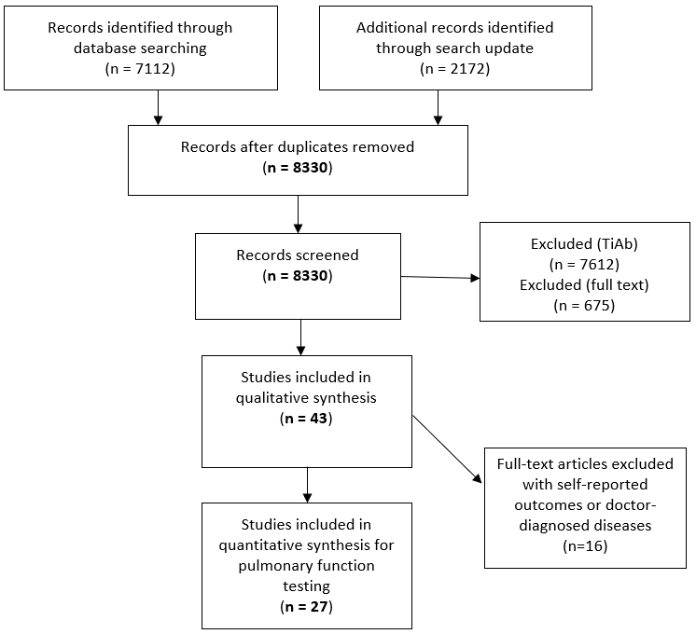
Results from literature search (WG1)
*
*Most recent search update June 2022

Slide 61
Conclusion of evidence

Slide 62
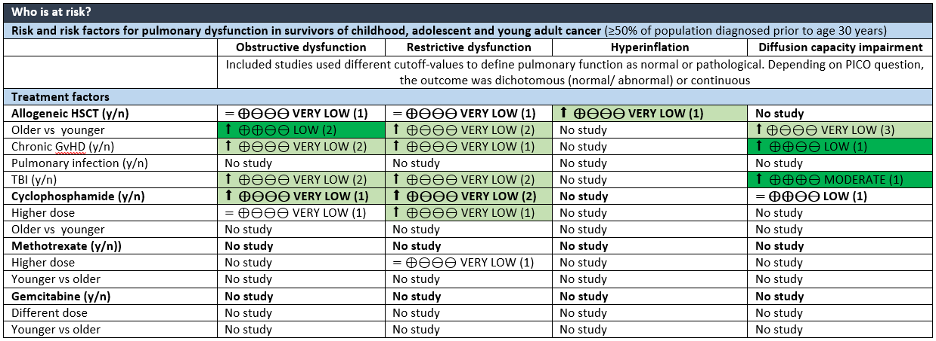

Conclusion of evidence
 | Increased risk; Low, moderate quality
 | Increased risk; Very low quality
 | Decreased risk; Very low quality

Slide 63
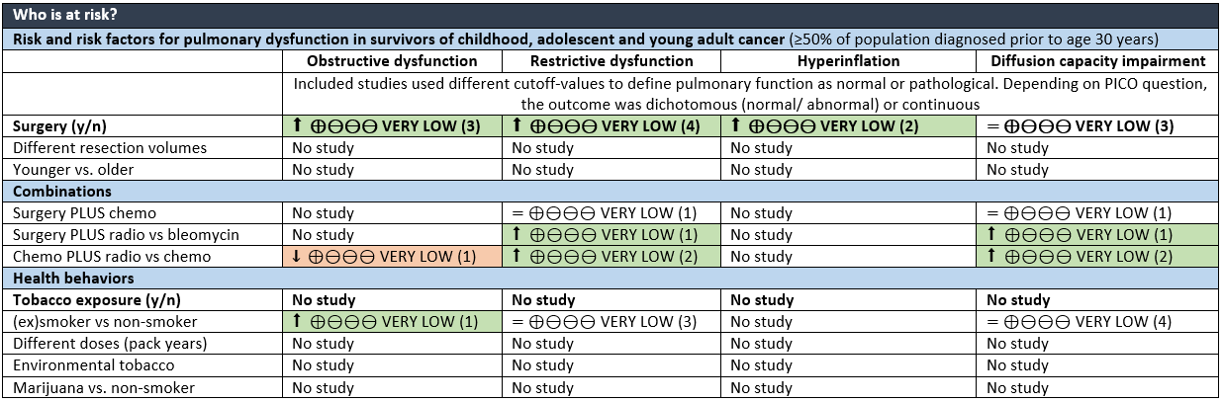
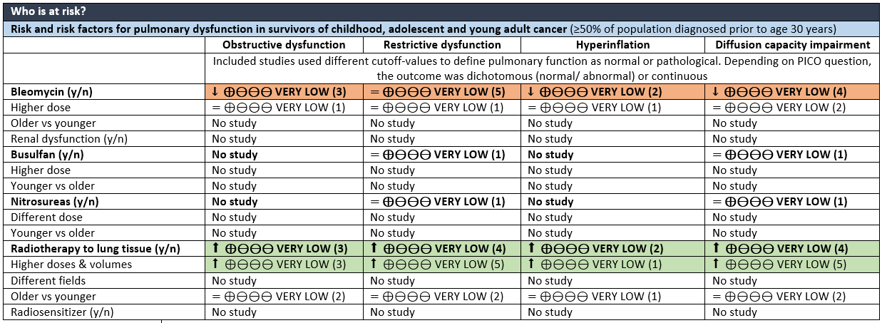
Conclusion of evidence
 | Increased risk; Low, moderate quality
 | Increased risk; Very low quality
 | Decreased risk; Very low quality

Slide 64
Evidence and translation into recommendations

Slide 65
Evidence and translation into recommendations (WG1)
Quality of evidence very low or low for most clinical questions
  Representativeness of study population / generalizability (small sample sizes, few exposed, selected cohorts, attrition bias)
  Imprecision (small study populations, few events, large confidence intervals, pulmonary function references values unclear or not adequate)
  Poor reporting of lung function testing procedures and results (unclear and heterogeneous reference values, binary cut-offs)
  Rarely opportunity to increase the quality
Recommendation for allogeneic hematopoietic stem cell transplantation, radiotherapy exposing lung tissue, surgery to the lung or chest wall
No recommendation for specific chemotherapeutic agents, dose-response relationship and longitudinal progression
Notes:
65

Slide 66
Evidence and translation into recommendations (WG2-4)
Expert opinion only
Guidelines from other populations not applicable
Tests: Spirometry > body plethysmography > measurement of diffusion capacity for carbon monoxide (DLCO)
Start: No data on longitudinal trajectory → unclear when to start surveillance and how frequently to repeat
Benefits versus harms
  Pulmonary function testing = not invasive and widely available (spirometry)
  No standard of care intervention or treatment option
  Psychological stress
Notes:
66

Slide 67
Discussion and next steps
Surprisingly little and methodologically poor data available
→ Not possible to answer all clinical questions
→ Not possible to make clear recommendations
→ More research is needed – internationally harmonized
Absence of evidence ≠ Absence of risk factors / pulmonary dysfunction

Slide 68
Discussion and next steps
Incorporate five studies form last search update
First manuscript draft to circulate to advisors and working group leaders | August 2022
Revised manuscript to guideline panel members | October 2022
Revised manuscript to expert reviewers and patient representatives | December 2022
Approval of final manuscript by IGHG core leadership group | February 2023

Slide 69
Thanks to
Chairs:
Claudia E. Kuehni
Andrew Dietz
Coordinator:
Maria Otth
Rahel Kasteler
Advisors:
Saro Armenian
Sandy Constine
Melissa Hudson
Leontien Kremer
Renée Mulder
Kevin Oeffinger
Rod Skinner
WG members:
Jennifer Agrusa
Dana Barnea
Anne Bergeron-Lafaurie
Christoph Berger
Neel Bhatt
Stephen Bourke
Elio Castagnola
Sandy Constine
Charlotte Demoor
Daniel Green
Myrofora Goutaki
WG members:
Ulrike Hennewig
Véronique Houdouin
Philipp Latzin
Anthony Ng
Cecile Ronckers
Christina Schindera
Saumini Srinivasan
Dennis C. Stokes
Birgitta Versluys
Nicolas Waespe
Daniel Weiner
Notes:
69

Slide 70
Dexrazoxane cardioprotection: IGHG recommendations
Elvira van Dalen
Princess Máxima Center for pediatric oncology
7 July 2022
Notes:
70

Slide 71
Content
Background
Scope
Conclusions of evidence
Translating evidence into recommendations
Recommendations (note: slides removed from this version which constitutes the minutes of the IGHG meeting)
Notes:
71

Slide 72
Background
Childhood cancer patients are at risk for anthracycline-induced cardiotoxicity
May be prevented by dexrazoxane, but there are concerns about its safety
To date, there is little guidance on its use in childhood cancer patients
To facilitate global consensus, the IGHG initiated the development of this guideline
Notes:
72

Slide 73
Scope
Target population
Childhood cancer patients (aged 21 years or younger at diagnosis) expected to receive anthracyclines
Interventions
Dexrazoxane versus placebo or no cardioprotective intervention
Outcomes
Benefits: reducing adverse cardiac outcomes (i.e. clinical heart failure, subclinical myocardial dysfunction and cardiac mortality)
Harms: a negative impact on tumor response, survival and adverse effects other than cardiac toxicity
Notes:
73

Slide 74
Conclusions of evidence
Notes:
We followed the well-known IGHG methodology and we came to the following conclusions of evidence

Slide 75

Overall conclusions of evidence#
Potential benefits:
Clinical heart failure (8): lower risk in dexrazoxane group in most analyses (very low to low quality evidence)
Clinical heart failure and subclinical myocardial dysfunction combined (8 and 6): lower risk in dexrazoxane group in most analyses (very low to low quality evidence)
Death resulting from heart failure (8): no significant difference (low quality evidence)
#Number reported after outcome indicates the importance of the outcome (where 9-7 stands for critical, 6-4 for important and 3-1 for low importance)
Potential harms:
Overall survival/mortality (9): no significant difference (very low to low quality evidence)
Progression-free survival (8): better in dexrazoxane group in some analyses, other analyses showed no significant difference (very low to low quality evidence)
Tumor response (6): no significant difference (very low to low quality evidence)
Other severe or life-threatening toxicities (6): results differed based on specific toxicity assessed
SMN (8): possible higher risk in dexrazoxane group (very low to low quality evidence)
Quality of life (4): no evidence

Slide 76

Harms: subsequent malignant neoplasms
Subsequent malignant neoplasms
Children RCT:
  Higher risk in dexrazoxane treated group
  (in available and worst-case analysis): RR 3.08 (95%CI 1.13-8.38)
  No significant difference between treatment groups
  (in best-case analysis): RR 2.51 (95%CI 0.96-6.53)
Adults RCT: no studies
Children observational: no significant difference between groups
⊕⊕⊖⊖ LOW
⊕⊕⊖⊖ LOW
⊕⊖⊖⊖ VERY LOW
Notes:
Let me show you our results on SMN in somewhat more detail: In the Cochrane review different types of analyses were done, namely available case, worst case and best case.
Overall there were no differences between these analyses for the evaluated outcomes, with the exception of SMN. But with same direction of effect, so a higher risk with dexrazoxane.

Slide 77
Translating evidence into recommendations
Notes:
For that we considered not only the evidence, but also other considerations, the balance of potential benefits and harms, and clinical judgements.

Slide 78
Examples of other considerations
Potential benefits:
It has been suggested that the cardio-protective effects associated with dexrazoxane are more pronounced in those who received doxorubicin ≥250 mg/m² (vs <250mg/m²)
Effect of dexrazoxane on cardiac outcomes is largely driven by RCTs in adults who received high doses of anthracyclines
→ provide separate recommendations for different anthracycline doses, using 250 mg/m² as the cut-off point

Slide 79
Examples of other considerations
Potential harms:
No significant difference in SMN related mortality (after follow-up of 18.6 years)
When evaluating the risk of SMN, we cannot fully rule out the possible effect of:
  etoposide and radiotherapy
  other chemotherapeutic agents
  genetic susceptibility
Multivariate analysis from an observational study demonstrated that etoposide is a significant risk factor of SMN, in contrast to dexrazoxane
Costs

Slide 80

Balance potential benefits and harms: < 250mg/m² anthracyclines
Cumulative doxorubicin or equivalent dose <250 mg/m²:
^{Potential benefits}
Are the desirable anticipated effects large?
Uncertain, because the absolute risk is lower compared to cumulative anthracycline dose ≥250 mg/m2 and the evidence is mainly based on studies with a high cumulative anthracycline dose
^{Potential harms}
Are the undesirable anticipated effects small?
Uncertain, because there is a possible risk of SMN
Are the desirable effects large relative to undesirable effects?
^{Uncertain}
Notes:
80
So what was the final balance for low doses of anthracyclines taking everything into account

Slide 81
Balance potential benefits and harms: ≥ 250mg/m² anthracyclines
Cumulative doxorubicin or equivalent dose ≥ 250 mg/m²:
^{Potential benefits}
Are the desirable anticipated effects large?
Probably yes, because the absolute risk of heart failure or myocardial dysfunction is high and the beneficial effect is based on studies with a high cumulative anthracycline dose
^{Potential harms}
Are the undesirable anticipated effects small?
Uncertain, because there is a possible risk of SMN
Are the desirable effects large relative to undesirable effects?
^{Probably yes}
Notes:
81

Slide 82

Thanks to
Chairs:
Saro Armenian
Annelies Mavinkurve-Groothuis
Coordinator:
Esmée de Baat
Advisors:
Elvira van Dalen
Renée Mulder
Leontien Kremer
Melissa Hudson
Paul Nathan
Funder:
The Dutch Heart Foundation [Grant CVON2015-21]
Expert panel:
Matthew Ehrhardt
Frederike Engels
Lieke Feijen
Heynric Grotenhuis
Jan Leerink
Livia Kapusta
Gertjan Kaspers
Remy Merkx
Luc Mertens
Roderick Skinner
Wim Tissing
Florent de Vathaire
Notes:
82
I want to finish with a big thank you to

Slide 83
IGHG Splenic Dysfunction
Surveillance
Bente Houtman
7 July 2022
Notes:
83

Slide 84
Content
Scope
Clinical questions
Selected evidence
Discussion of important issues
Notes:
84

Slide 85
Scope and definitions
Target population
Childhood, adolescent and young adult cancer survivors at risk for splenic dysfunction
Treated for cancer up to age 35 years
Immediately post-treatment
Outcomes
Overwhelming sepsis, defined as:
Severe infection for which hospitalisation was needed
Death due to infection
Notes:
85
No screening test available for splenic funciton.

Slide 86
Clinical questions
Notes:
Guidelines by COG, CCLG, DCOG

Slide 87
WG1
Which survivors are at risk for splenic dysfunction?
What is the risk of overwhelming infection in CAYA cancer survivors treated with:
Radiotherapy exposing the spleen?
  Threshold dose
  Volume
Hematopoietic stem cell transplantation?
  Autologuous/allogeneic
  Conditioning with TBI
  Active cGVHD
Immunotherapy?
Notes:
87

Slide 88
WG2
What test can reliably diagnose splenic dysfunction?
What is the diagnostic value (sensitivity, specificity, predictive value) for detecting splenic hypofunction in CAYA cancer survivors compared to ⁹⁹Tc-labelled, heat-altered erythrocyte SPECT/CT for:
Howell-Jolly bodies
Pitted erythrocytes
IgM memory B-cells
Tuftsin
Ultrasound
Notes:
88

Slide 89
WG3
What guidance should be provided to survivors with splenic dysfunction?
Counseling
Does counseling reduce the risk for overwhelming infection?
Travel
Does the use of anti-malarial medication reduce the risk for overwhelming infection in CAYA cancer survivors at risk for splenic dysfunction?
Are CAYA cancer survivors at risk for splenic dysfunction at increased risk for babesiosis?
Medical alert bracelet
Does the use of a medical alert bracelet have a positive effect on awareness for medical personnel?
Notes:
89

Slide 90
WG3
What guidance should be provided to survivors with splenic dysfunction?
Vaccines
What is the immunogenicity of:
Pneumococcal vaccine
Meningococcal vaccine
Hemophilus influenzae type B
Influenza vaccine
COVID vaccine
Notes:
90

Slide 91
WG3
What guidance should be provided to survivors with splenic dysfunction?
Prophylactic antibiotics
Does the use of prophylactic antibiotics reduce the risk of overwhelming infection?
On demand antibiotics
What is the efficacy of the use of on demand antibiotics in CAYA cancer survivors with infective symptoms or animal/human bites with skinbreak?
Notes:
91

Slide 92
Selected evidence

Slide 93
Search strategy
1. Population: Childhood cancer + testis cancer + breast cancer | Search 1 AND 2 AND (3 OR (4 AND 5)) Filter: Human English language Published from 1-1-1980 onwards
2. Population: Survivors
3. Determinant: Spleen
4. Outcome: Infections
5. Outcome: Hospitalization or death
Hits (1-12-2021): n= 2063
Notes:
93

Slide 94
Included studies
Pubmed search results
n = 2063
Excluded
n = 1950
Abstracts selected
n = 113
Excluded
n = 109
Ineligible study design
Small sample size
Outcomes not relevant
Not CAYA cancer survivors
Full texts selected
n = 4
Notes:
94

Slide 95
Included studies
 | Population | Treatment | Outcomes
Weil Journal of Clinical Oncology, 2018 | N = 20,026 5-year CCS Age at diagnosis: 7.0y () Follow-up time: 26y () | Splenectomy: 6.8% Splenic radiation: 46% <10 Gy: 39.3% 10-19.9 Gy: 5.1% ≥20 Gy: 2.6% | Infection related late mortality at 35y. Association between splenectomy, splenic irradiation and infection related mortality.
Pelland Leukemia & Lymphoma, 2020 | N = 6148 CCS Age at diagnosis: 5y (IQR 2.0-11.0) Follow-up time: 1095d (IQR 655-1500) | Chemotherapy: 69.8% HSCT: 6.9% Radiation: 3.7% | Risk for severe infections (grade 4-5) in CCS.
Perkins Cancer, 2014 | N = 12,360 5-year CCS Age at diagnosis: <21y Age at follow-up: 22% >40y Controls N= 4,023 siblings U.S. infection-related SMR | Splenectomy: 8.8% Abdominal RT: 21.7% Chest RT: 22.5% TBI: 1.1% Chemotherapy: 66.2% Steroids: 38.2% | Infection related death rate of CCS compared to the U.S. population.
Wilhelmsson American Journal of Hematology, 2020 | N = 196 5-year childhood AML survivors Age at diagnosis: <18y Follow-up time: 12y (range 5-28) Controls N = 152,231 matched on sex, age, country. | Chemotherapy: 51% Chemotherapy + HSCT: 49% TBI: 61% | Hospitalizations for infections in CCS stratified by treatment group.
Notes:
95
Immunotherapy
Diagnostic tests
Guidance

Slide 96
Next step
Look into evidence-based guidelines regarding different patient groups at risk for splenic dysfunction.
Notes:
96
* Publications and guidelines in progress

Slide 97
Discussion

Slide 98
Discussion
What populations would be suitable to extract additional information from?
  (different patient groups also at risk for splenic dysfunction)
How to formulate recommendations when using a proxy marker for splenic dysfunction?
Notes:
98

Slide 99
Thanks to
Chairs:
Jacqueline Loonen
Greg Guilcher
Coordinator:
Bente Houtman
Advisors:
Leontien Kremer
Melissa Hudson
Rod Skinner
Sandy Constine
Hamish Wallce
Renée Mulder
Elvira van Dalen
WG leader:
Danielle Friedman
Jacqueline Loonen
Greg Guilcher
WG members:
Mark Gaze
Charlotte Demoor
Brent Weil
Lorna Zadravec Zaletel
Jelena Roganovic
Katrin Scheinemann
Anna Panasiuk
Claire Berger
Jennifer Heimall
WG members:
Nicola Wright
Annechien Lambeck
Audrone Mulevičiene
Andrew Gennery
Edit Bardí
Katerina Katsimbardi
Matthew Matasar
Dimitri Diavatopoulos
Louis Bont
Austen Worth
Arjan van Laarhoven
Michelle Kwok-Williams
Paula Adkin
Judith Spijkerman
Notes:
99

Slide 100
IGHG colorectal cancer surveillance
Jop Teepen
7 July 2022
Notes:
100

Slide 101

Content
Scope
Conclusions of evidence
Translating evidence into recommendations
Current status
Notes:
101

Slide 102
Scope
Target population
Childhood, adolescent and young adult cancer survivors treated for cancer before age 30
Outcomes
Colorectal cancer
Notes:
102

Slide 103
Conclusions of evidence

Slide 104
Does early diagnosis result
in better outcome?
Outcome of early diagnosis in CAYA cancer survivors
Unknown whether the detection of a colorectal cancer in a smaller size or asymptomatic stage contributes to
  ↓ recurrence rate
  ↑ survival rate
  ↓ treatment-related complications
  ↑ quality of life
No studies
Notes:
104

Slide 105
Who needs surveillance for
subsequent colorectal cancer?
Risk of subsequent colorectal cancer in CAYA cancer survivors
Absolute excess risks per 10,000 person-years ranges from 0.4 to 6
Cumulative incidence ranges from 0.2% to 0.4% at 20-yr follow-up and from 0.41% to 2.4% at 30-yr follow-up
⊕⊕⊕⊖ MODERATE
⊕⊕⊕⊖ MODERATE
Notes:
105

Slide 106
Who needs surveillance for
subsequent colorectal cancer?
Risk of subsequent colorectal cancer in CAYA cancer survivors
↑ risk after abdominal radiotherapy
↑ risk after higher doses of abdominal radiotherapy
Unknown risk for radiotherapy location/field
Unknown risk for radiotherapy type
Unknown risk for radiotherapy fractionation dose
↑ risk after increasing number of colonic segments irradiated
↑ risk at younger age at primary cancer diagnosis
↑ risk after chemotherapy
↑ risk after alkylating agents
Unclear risk after anthracyclines
Unknown risk after platinum agents
⊕⊕⊕⊕ HIGH
⊕⊕⊕⊖ MODERATE
No studies
⊕⊖⊖⊖ VERY LOW
⊕⊕⊖⊖ LOW
⊕⊕⊖⊖ LOW
⊕⊕⊕⊖ MODERATE
⊕⊖⊖⊖ VERY LOW
No studies
Notes:
106

Slide 107
Who needs surveillance for
subsequent colorectal cancer?
Risk of subsequent colorectal cancer in CAYA cancer survivors
No significant effect of gender
Unknown risk for genetic predisposition
Unknown risk for lifestyle factors
↑ prevalence of colorectal adenomas after screening with colonoscopy vs. matched controls
⊕⊕⊕⊖ MODERATE
No studies
⊕⊕⊖⊖ LOW
Notes:
107

Slide 108
When should surveillance be initiated?
At what frequency should it be performed?
Latency time of subsequent colorectal cancer in CAYA cancer survivors
Latency ranged from median 20.2 to 30 years after primary cancer diagnosis, with a range from minimal 4.7 years to at least 49.4 years
⊕⊕⊕⊖ MODERATE
Risk over time of subsequent colorectal cancer in CAYA cancer survivors
Cumulative incidence ↑ over time, which does not seem to plateau
No specific trends over time in standardized incidence ratio
⊕⊕⊕⊖ MODERATE
⊕⊕⊖⊖ LOW
Notes:
108

Slide 109
What surveillance modality should be used
for the detection of colorectal cancer?
Diagnostic value and harms of surveillance modalities in CAYA cancer survivors
Unknown diagnostic value of
  Fecal immunochemical testing
  Occult blood testing
  Stool DNA testing
  CT colonography
  Flexible sigmoidoscopy
Unknown harms of screening
No studies
vs. colonoscopy
No studies
Notes:
109

Slide 110
Translating evidence into recommendations

Slide 111
COG guideline
Who? Radiotherapy exposure to abdomen, pelvis, spine, or TBI
When start? Beginning 5 years after radiation or at age 30 years (whichever occurs last)
Modality? Multitarget stool DNA test (every 3 years) OR colonoscopy (every 5 years)
Notes:
111

Slide 112
General population recommendations
Guideline | Age? | Modality? | Frequency?
U.S. Multi-Society Task Force on Colorectal Cancer (2021) | 45-75 | High-sensitivity guaiac fecal occult blood test (HSgFOBT) or fecal immunochemical test (FIT) Stool DNA-FIT CT colonography Flexible sigmoidoscopy Flexible sigmoidoscopy + FIT Colonoscopy screening | HSgFOBT or FIT: annual Stool DNA-FIT: every 1-3 y CT colonography: every 5 y Flexible sigmoidoscopy: every 5 y Flexible sigmoidoscopy every 10 y + FIT annual Colonoscopy screening: every 10 y
American Cancer Society (2018) | 45-75 | High-sensitivity stool-based test or a structual (visual) examination, depending on patient preference and availability | Colonoscopy: every 10 y FIT: annual High-sensitivity guaiac-based fecal occult blood test: annual Multitarget stool DNA test: every 3 y CT colonography: every 5 y Flexible sigmoidoscopy: every 5 y
Canadian Task Force on Preventive Health | 50-74 | FIT guaiac fecal occult blood testing Flexible sigmoidoscopy | FIT: every 2 y guaiac fecal occult blood testing: every 2 y Flexible sigmoidoscopy: every 10 y
Cancer Council Australia (2018) | 50-74 | FIT | Every 2 y
UK National Screening Committee | 60-74 | FIT | Every 2 y
Netherlands | 55-75 | FIT | Every 2 y
Notes:
112

Slide 113
High-risk population recommendations
Guideline | Who? | Age? | Modality? | Frequency?
U.S. Multi-Society Task Force on Colorectal Cancer (2018) / (1) STRONG RECOMMENDATION (2) NO STRENGTH MENTIONED (3) AND (4) WEAK RECOMMENDATION | Lynch syndrome Family Colon Cancer Syndrome X CRC or advanced adenoma in 2 FDR at any age or 1 FDR age <60 CRC or advanced adenoma in 1 FDR age ≥60 | 20-25 or 2-5 y younger than diagnosis of CRC in family if diagnosis <age 25 10 y before age of diagnosis of youngest FDR 10 y before age of diagnosis of youngest FDR or age 40 y 40 y | colonoscopy colonoscopy colonoscopy as in general population | Every 1-2 y Every 3-5 y Every 5 y as in general population
Cancer Council Australia (2018) I ALL EXPERT OPINION | 1 relative with CRC age 55+ 1 FDR with CRC age <55 OR 2 FDR with CRC at any age OR 1 FDR and 2 SDR with CRC at any age 3 FDR or SDR with CRC, with at least one diagnosed age <55 OR 3 FDR at any age | 45-74 y 40-74 y 35-74 y | FIT FIT age 40-50, colonoscopy age 50-74 FIT age 35-45, colonoscopy age 45-74 | Every 2 y FIT every 2 y, colonoscopy every 5 y FIT every 2 y, colonoscopy every 5 y
UK National Screening Committee (1) AND (5) WEAK RECOMMENDATION (2) AND (3) AND (4) STRONG RECOMMENDATION | High-risk: 3 close relatives with CRC Moderate risk: 1 close relative CRC age <50 or 2 close relatives CRC any age Lynch syndrome Familial Adenomatous Polyposis MUTYH-associated polyposis (MAP) | 40-75 y 55 y 25 or 35 y 12-14 y 18-20 y | colonoscopy colonoscopy colonoscopy colonoscopy | Every 5 y 1 colonoscopy and take part in national screening Every 2 y Every 1-3 y Annual
Notes:
113

Slide 114
Potential benefits of surveillance
Screening for colorectal cancer with several different methods can accurately detect adenomatous polyps and colorectal cancer in an early stage with the potential for better outcomes (improved life expectancy, quality of life, decreased morbidity related to avoidance of new cancer treatment) among CAYA cancer survivors (no evidence).
Stool-based tests and structural examinations reduce colorectal cancer mortality among asymptomatic adults in the general population (evidence from other guidelines).
A modeling showed that early initiation of colonoscopy screening in childhood cancer survivors is cost-effective, especially among those treated with abdominopelvic radiotherapy (one study)
Stool-based tests, colonoscopy, and CT colonography have good diagnostic value for the detection of colorectal cancer in average-risk people in the general population (evidence from other guidelines).
CAYA cancer survivors who do not have a colorectal cancer detected when they undergo surveillance may benefit from being reassured that they do not have a new cancer (expert opinion).
Notes:
114

Slide 115
Potential harms of surveillance
Direct visualization tests, especially colonoscopy, have a risk of bleeding and perforation (evidence from other guidelines).
Undergoing surveillance might result in fear and anxiety for patients (although the stress and anxiety generally resolve post screening) and the self-perception of being a patient versus healthy (expert opinion).
Colorectal cancer surveillance may result in false-positive findings leading to unnecessary emotional stress, anxiety and costs of further testing and biopsies (expert opinion).
Colorectal cancer surveillance may result in false-negative findings, leading to false reassurance (expert opinion).
Colonoscopy is costly.
Notes:
115

Slide 116
Current status
Formulating draft recommendations for surveillance
Discuss with core group and guideline panel
Especially discussion on age at start screening and modality
Notes:
116

Slide 117

Thanks to
Chairs:
Tara Henderson
Raoul Reulen
Coordinator:
Jop Teepen
Advisors:
Renée Mulder
Leontien Kremer
Melissa Hudson
Louis Constine
Hamish Wallace
Rod Skinner
Kevin Oeffinger
David Hodgson
WG leaders:
Monica Gramatges
Charlotte Demoor
Danielle Friedman
Paul Nathan
WG members:
Maëlle de Ville de Goyet
Alexandra Walsh
Melissa Acquazzino
S. Ashley Speckhart
Maria Spavor
Heather Allewelt
Jelena Roganovic
Edit Bardi
Kayla Foster
WG members (cont.):
Antony Ng
Elvira van Dalen
Monica Terenziani
Ulrike Hennewig
Alia Zaidi
Emma Plant
Joshua Palmer
Kelly Kramer
Karen Kim
Colin Rees
Sheldon Cooper
Lucie Turcotte
Jaap den Hartogh
Chaya Moskowitz
Notes:
117

Slide 118
IGHG Cardiomyopathy
Surveillance
Matthew J. Ehrhardt, MD, MS
Jan M. Leerink, MD, PhD Candidate
7 July 2022
Notes:
118

Slide 119
Content
Scope
Conclusions of evidence
Translating evidence into recommendations
Recommendations
Notes:
119

Slide 120
Scope
Target population
Childhood, adolescent and young adult cancer survivors treated for cancer up to age ≤25 years and ≥2 years post-treatment who were previously treated with anthracycline chemotherapy and/or chest-directed radiotherapy (RT) where the heart was in the RT field.
Outcomes
Asymptomatic cardiomyopaty (asymptomatic left ventricular dysfunction)
Symptomatic cardiomyopathy (symptomatic heart failure)
Notes:
120

Slide 121
Conclusions of Evidence

Slide 122
Who needs cardiomyopathy surveillance?
Risk factors for symptomatic heart failure (HF) and asymptomatic left ventricular dysfunction (ALVD) in CAYA cancer survivors
 | Symptomatic HF (range of RR/HR/OR) | ALVD (range of RR/HR/OR)
Treatment factors
Higher anthracycline dose | ⬆ ⊕⊕⊕⊕ HIGH ^{5-18,32,35-38} | ⬆ ⊕⊕⊕⊕ HIGH ^{1-4,19-31,33,39}
1-99 mg/m² vs none | = ^{6,11,13} | LVEF = ^{26,39}; GLS ⬆ 1·4-fold²⁶
100-249 mg/m² vs none | ⬆ 3·7 to 3·9-fold^{6,13} | -
100-299 mg/m² vs none | - | LVEF ⬆ 2·7 to 3·8-fold^{6,39}; GLS = ²⁶
≥250 mg/m² vs none | ⬆ 5·2 to 94·0-fold ^{5,6,8,9,11,13,15,35,36,38} | -
≥300 mg/m² vs none | - | LVEF ⬆ 4·1 to 12·8-fold^{6,39}; GLS ⬆ 1·7-fold²⁶
Higher chest RT dose | ⬆ ⊕⊕⊕⊕ HIGH ^{5-9,11,12,15,17,18,35,36,40-42} | ⬆ ⊕⊕⊕⊕ HIGH ^{21,22,25-27,30}
1-14 Gray vs none | = ^{5,6,8,9,11,15,17,36,42} | No thresholds can be defined
15-30/34 Gray vs none | ⬆ 1·6 to 6·1-fold^{5,6,8,9,11,15,35,36} | No thresholds can be defined
≥30/35 Gray vs none | ⬆ 3·5 to 19·7-fold ^{5,6,8,9,11,15,35,36} | No thresholds can be defined
Larger volume of the heart exposed to RT | ⬆ ⊕⊕⊕⊕ HIGH ^{9,36} | No studies
Anthracyclines + chest RT vs treatment with either alone | ⬆ ⊕⊕⊕⊕ HIGH ^{7,9,12,17,35,36,43} | No studies
Interaction of female sex with anthracycline dose | = ⊕⊖⊖⊖ VERY LOW ¹¹ | No studies
Interaction of younger age at diagnosis with anthracycline dose | ⬆ ⊕⊕⊖⊖ LOW ^{9,11} | No studies
Interaction of sex and age at diagnosis with chest RT dose | No studies | No studies
Relative potency of anthracycline analogues | ⊕⊕⊕⊖ MODERATE ^{35,38} | No studies
Daunorubicin vs doxorubicin | ⬇ 0·5 to 0·6-fold | No studies
Epirubicin vs doxorubicin | ⬇ 0·8-fold | No studies
Mitoxantrone vs doxorubicin | ⬆ 10·5 to 13·8-fold | No studies
Idarubicin vs doxorubicin | Unclear | No studies
Dexrazoxane (from IGHG dexrazoxane guideline) | Children RCTs: ⬇ pooled RR 0·20 (95% CI 0·01-4·19), not significant ⊕⊕⊖⊖ LOW (3 pediatric RCTs) Adult RCTs: ⬇ pooled RR 0·22 (95% CI 0·11-0·43), ⊕⊕⊖⊖ LOW (7 adult RCTs) | Children RCT: ⬇ for HF and ALVD combined: RR 0·33 (95% CI 0·13-0·85) ⊕⊕⊖⊖ LOW (1 pediatric RCT) Adult RCTs: ⬇ for HF and ALVD combined: RR 0·37 (95% CI 0·24-0·56) ⊕⊕⊕⊖ MODERATE (3 adult RCTs)
New childhood cancer treatments | No studies | No studies
Notes:
122

Slide 123
Who needs cardiomyopathy surveillance?
Host factors
Female sex | ⬆ ⊕⊕⊕⊖ MODERATE ⁵⁻¹⁸ | = ⊕⊕⊕⊖ MODERATE^{1-4,19-31}
Younger age at diagnosis | ⬆ ⊕⊕⊖⊖ LOW ^{6-8,10-13,15-17,32} | = ⊕⊕⊖⊖ LOW ^{1-4,19-21,23,25-31,33}
Pregnancy, no previous cardiomyopathy | = Incidence 0·24% (95% CI 0-0·81%) ⊕⊕⊖⊖ LOW ³⁴
Pregnancy, previous cardiomyopathy | ⬆ Incidence 28% 95% (CI 15-44%) ⊕⊕⊖⊖ LOW ³⁴
Traditional CVRF
Diabetes | ⬆ ⊕⊕⊕⊖ MODERATE^{5,6,11,14,36,37,43} | ⬆ ⊕⊕⊕⊖ MODERATE^{20,25,26}
Dyslipidemia | ⬆ ⊕⊕⊕⊖ MODERATE^{5,6,11,14,43} | ⬆ ⊕⊕⊖⊖ LOW^{25,26}
Obesity | ⬆ ⊕⊕⊖⊖ LOW^{11,36} | ⬆ ⊕⊕⊕⊖ MODERATE^{20,25,26}
Hypertension | ⬆ ⊕⊕⊕⊕ HIGH^{5,6,11,14,37,43} | ⬆ ⊕⊕⊕⊖ MODERATE^{20,25,26}
Smoking | ⬆ ⊕⊕⊕⊖ MODERATE^{9,36,43} | = ⊕⊕⊕⊖ MODERATE^{1,20,25}
Genetic variants with moderate level of evidence | Effect size | CPNDS level of evidence | PharmGKB level of evidence
RARG (retinoic acid receptor gamma) rs2229774 | ⬆ OR 4·1-7·0^{44,45} | Moderate (+++) | Low (level 3)
UGT1A6 (UDP-glucosyltransferase A1) rs17863783 | ⬆ OR 4·0-8·0⁴⁵⁻⁴⁷ | Moderate (+++) | Unsupported (level 4)
 | Symptomatic HF | Asymptomatic LV dysfunction
Anthracyclines | No studies | Median 4·3 months ⊕⊕⊖⊖ LOW⁶⁸
Chest RT | No studies | No studies
Anthracyclines and chest RT | Range 0·1-35·7 years ⊕⊕⊕⊖ MODERATE^{12,16} | Range 1-42 years ⊕⊕⊕⊖ MODERATE^{21,22,31,33,69,70}
Anthracyclines and dexrazoxane | No studies | No studies
Impact of early changes on latency | No studies | = ⊕⊖⊖⊖ VERY LOW⁷¹
Do early changes predict late changes | No studies | ⬆ ⊕⊕⊖⊖ LOW^{31,70-73}
Difference in latency in low-, moderate-, and high-risk survivors | Decrease in age at onset of HF with higher anthracycline and/or chest-directed RT dose ⊕⊕⊕⊖ MODERATE^{65,67}
Different anthracycline derivatives | No studies | No studies
Does risk change over time | Cumulative incidences: ⬆ at higher anthracycline doses ⊕⊕⊕⊖ MODERATE^{5,6,8-11,15,16,36,37,46,65-68} | ⬆ at higher anthracycline doses Plateaus at doses <250 mg/m² ⊕⊖⊖⊖ VERY LOW^{33,66,69,74}
Genetic variants | No studies | No studies
Notes:
123

Slide 124
What surveillance modality should be used?
Agreement between modalities and diagnostic values
 | Outcome | Quality of evidence
Agreement M-mode echocardiography and cardiac magnetic resonance imaging (CMR) LVEF | Mean difference 3·1% to 5·5% lower for CMR (1·96SD range: 12·3-25·2%) | ⊕⊕⊕⊖ MODERATE⁴⁸⁻⁵⁰
Agreement 2D echocardiography and CMR LVEF | Mean difference 1·8% to 5·4% lower for CMR (1·96SD range: 10·8-13·8%) | ⊕⊕⊕⊖ MODERATE⁴⁸⁻⁵⁰
Agreement 3D echocardiography and CMR LVEF | Mean difference 1·1% higher for CMR to 7% lower for CMR (1·96SD range: 10·4-12·9%) | ⊕⊕⊕⊖ MODERATE⁴⁸⁻⁵⁰
Agreement 2D and 3D echocardiography LVEF | No studies in CAYA cancer survivors. Evidence in the general population^{51,52} Bland Altman analysis: -2D echocardiography - CMR LVEF: mean pooled difference/bias 0·1%, 2SD 13·9% -3D echocardiography - CMR LVEF: mean pooled difference/bias 0·0%, 2SD 9·2% -Difference in bias of 2D and 3D LVEF compared to CMR was not statistically significant (p=0·42) -Difference in variance of 2D and 3D LVEF compared to CMR was statistically significant (p<0·001) | Not graded
What is the recommended modality to measure LV systolic function and what are the thresholds for abnormal? | No studies in CAYA cancer survivors. Evidence in the general population⁵² -LV systolic function should be assessed with 2D or 3D echocardiography by calculating LVEF from EDV and ESV. -EDV and ESV should be assessed on 2D echocardiography using the biplane method. In laboratories with experience in 3D echocardiography, 3D measurement and reporting of LV volumes is recommended when feasible depending on image quality. -LVEFs of <52% for men and <54% for women are suggestive of abnormal LV systolic function. | Not graded
N-terminal pro B-type natriuretic peptide (NT-proBNP) as compared to echocardiography or CMR | -Low sensitivity (8%-100%). When one study that did not report the NT-proBNP cut-off for abnormal is excluded the sensitivity is very low (ranging from 8%-32%). -High specificity (81%-100%) | ⊕⊕⊕⊖ MODERATE^{28,49,53-61}
Atrial natriuretic peptide or brain natriuretic peptide as compared to echocardiography | Moderate sensitivity (63%), high specificity (96%) | ⊕⊕⊖⊖ LOW⁶²
Troponin T and I as compared to echocardiography or CMR | Low sensitivity (0-50%), high specificity (91-100%) | ⊕⊕⊕⊖ MODERATE^{49,53-58,61,63,64}
Exercise stress echocardiography compared to diastolic function assessment by echocardiography for detecting asymptomatic restrictive cardiomyopathy in CAYA cancer survivors treated with cardiac RT | Unknown | No studies
Unknown if risk stratification methods, such as risk groups defined by the IGHG, can be used to guide preventive treatments |  | No studies
Notes:
124

Slide 125
At what frequency should cardiomyopathy surveillance be performed?
Latency to onset of and risk over time for asymptomatic/symptomatic cardiomyopathy in CAYA cancer survivors
 | Symptomatic HF | Asymptomatic LV dysfunction
Anthracyclines | No studies | Median 4·3 months ⊕⊕⊖⊖ LOW⁶⁸
Chest RT | No studies | No studies
Anthracyclines and chest RT | Range 0·1-35·7 years ⊕⊕⊕⊖ MODERATE^{12,16} | Range 1-42 years ⊕⊕⊕⊖ MODERATE^{21,22,31,33,69,70}
Anthracyclines and dexrazoxane | No studies | No studies
Impact of early changes on latency | No studies | = ⊕⊖⊖⊖ VERY LOW⁷¹
Do early changes predict late changes | No studies | ⬆ ⊕⊕⊖⊖ LOW^{31,70-73}
Difference in latency in low-, moderate-, and high-risk survivors | Decrease in age at onset of HF with higher anthracycline and/or chest-directed RT dose ⊕⊕⊕⊖ MODERATE^{65,67}
Different anthracycline derivatives | No studies | No studies
Does risk change over time | Cumulative incidences: ⬆ at higher anthracycline doses ⊕⊕⊕⊖ MODERATE^{5,6,8-11,15,16,36,37,46,65-68} | ⬆ at higher anthracycline doses Plateaus at doses <250 mg/m² ⊕⊖⊖⊖ VERY LOW^{33,66,69,74}
Genetic variants | No studies | No studies
Cost-benefit ratio of surveillance strategies (including frequencies) in CAYA cancer survivors in different risk groups for cardiomyopathy
 |  | Quality of evidence
Echo surveillance is not cost-effective in low-risk CAYA cancer survivors treated with anthracyclines <100 mg/m² and/or chest-RT <15 Gray |  | ⊕⊕⊕⊖ MODERATE⁶⁵⁻⁶⁷
Echo surveillance may be cost-effective at 5-year intervals in moderate-risk CAYA cancer survivors treated with anthracyclines 100-249 mg/m² or chest-RT 15-34 Gray |  | ⊕⊕⊖⊖ LOW⁶⁵⁻⁶⁷
Echo surveillance is cost-effective at 2-year intervals in high-risk CAYA cancer survivors treated with anthracyclines ≥250 mg/m², chest RT ≥35 Gy or a combination |  | ⊕⊕⊕⊖ MODERATE⁶⁵⁻⁶⁷
CMR surveillance may be cost-effective at 10-year intervals in low- to moderate-risk CAYA cancer survivors treated with anthracyclines <250 mg/m² |  | ⊕⊕⊖⊖ LOW⁶⁵
CMR surveillance is cost-effective at 5-year intervals in high-risk CAYA cancer survivors treated with anthracyclines ≥250mg/m² |  | ⊕⊕⊖⊖ LOW⁶⁵
Notes:
125

Slide 126
What should be done when abnormalities are identified?
Effectiveness of medical interventions in CAYA cancer survivors with ALVD to prevent HF
 | Quality of evidence
Unclear if ACE inhibitors are effective for improving cardiac function or preventing HF in CAYA cancer survivors with ALVD* | ⊕⊕⊖⊖ LOW⁷⁵
Unknown if beta-blockers are effective for improving cardiac function or preventing HF in CAYA cancer survivors with ALVD | No evidence from RCTs
Unknown if angiotensin II receptor blocker are effective for improving cardiac function or preventing HF in CAYA cancer survivors with ALVD who are intolerant to ACE inhibitors | No evidence from RCTs
Effectiveness of medical interventions in the general population with ALVD to prevent HF
 | Quality of evidence from evidence-based guidelines**
ACE inhibitors are effective for preventing HF in individuals with asymptomatic LVEF<40% (range <35% to ≤40%) | MODERATE⁷⁶⁻⁷⁸ to HIGH⁷⁹⁻⁸¹
Beta-blockers are effective for preventing HF in individuals with asymptomatic LVEF<40% (range <35% to ≤40%) | LOW in all patients⁷⁹; MODERATE in patients with a previous myocardial infarction⁷⁶⁻⁸⁰
Angiotensin II receptor blockers are effective for preventing HF in individuals with asymptomatic LVEF<40% (range <35% to ≤40%) and a history of myocardial infarction of vascular disease who are intolerant to ACE inhibitors | LOW in all patients⁷⁸; HIGH in patients with myocardial infarction or vascular disease^{76,79,80}
Treating hypertension is effective for preventing HF in individuals with hypertension and asymptomatic LV dysfunction | HIGH⁷⁹
Use of risk stratifying methods for the decision to use preventive treatments in CAYA cancer survivors
 | Quality of evidence
Unknown if risk stratification methods, such as risk groups defined by the IGHG, can be used to guide preventive treatments | No studies
Effectiveness of physical activity and (lifestyle) interventions to prevent HF in CAYA cancer survivors who received cardiotoxic cancer treatments and have normal left ventricular (LV) function
 | Quality of evidence
Unknown if physical activity and lifestyle interventions are effective for preventing HF in CAYA cancer survivors with normal LV function | No studies
Effectiveness of physical activity and lifestyle interventions to prevent HF in other populations with normal LV function
 | Quality of evidence from evidence-based guidelines**
Physical activity is effective for preventing HF in individuals with normal LV function | LOW⁷⁷ to MODERATE^{76,80,82}
Treating hypertension is effective for preventing HF in individuals with normal LV function | MODERATE⁷⁶ to HIGH^{77,79,80,82}
Treating lipid disorders is effective for preventing HF in individuals with normal LV function | LOW in all patients⁷⁹; HIGH in patients with or at high-risk of cardiovascular disease^{77,79,82}
Treating diabetes type II is effective for preventing HF in individuals with normal LV function | LOW^{77,79} to MODERATE^{76,78,82}
SGLT2 inhibitors are effective for preventing HF in individuals with normal LV function and with diabetes at high-risk of cardiovascular disease or with cardiovascular disease | HIGH^{76,77,80,82-85}
Treating obesity is effective for preventing HF in individuals with normal LV function | LOW^{77,79} to MODERATE^{78,82}
Smoking cessation is effective for preventing HF in individuals with normal LV function | LOW^{77,79,80} to MODERATE⁸²
Reducing excessive alcohol intake is effective for preventing HF in individuals with normal LV function | LOW^{77,79,80,82}
ACE inhibitors or angiotensin II receptor blockers are effective for preventing HF in individuals with coronary artery disease, atherosclerotic vascular disease, diabetes and/or hypertension and normal LV function | HIGH^{76,77,79,80}
Notes:
126

Slide 127
Translating Evidence into Recommendations

Slide 128
Benefits and Harms of Cardiomyopathy Surveillance
 | Echo (3D or 2D LVEF*) | CMR | Blood biomarkers
High-risk (anthracyclines ≥250 mg/m², chest RT ≥30 Gy, or a combination of anthracyclines ≥100 mg/m², and chest RT ≥15 Gy) | ⊕ High-risk of HF (>3·5-fold) ⊕ Widely available, cheap, and cost-effective at 2-year intervals ⊖ Reasonable agreement with CMR** | ⊕ High-risk of HF (>3·5-fold) ⊕ High reproducibility, cost-effective at 5-year intervals ⊖ Costs, availability, waiting times, interpretability by practitioners, and burden for survivors | ⊖ Poor diagnostic value of biomarkers
Balance of benefits (⊕) and harms (⊖)
Undesirable consequences clearly outweigh desirable consequences in most settings | Undesirable consequences probably outweigh desirable consequences in most settings | Desirable and undesirable consequences are closely balanced or uncertain | Desirable consequences probably outweigh undesirable consequences in most settings | Desirable consequences clearly outweigh undesirable consequences in most settings
*2D in centers without experience with 3D and/or insufficient image quality. **1) Cost-effectiveness studies weighted for misclassification of echo compared to CMR; 2) HF medication trials in asymptomatic individuals in the general population used echo to define LV dysfunction and start treatment. Abbreviations: 3D=three-dimensional; 2D=two-dimensional; LVEF=left ventricular ejection fraction; CMR=cardiac magnetic resonance imaging; ≥=greater than or equal to; mg/m²=milligrams per square meter; RT=radiotherapy to the chest region; Gy=Gray; >=greater than; <=less than; HF=heart failure

Slide 129
Benefits and Harms of Cardiomyopathy Surveillance
 | Echo (3D or 2D LVEF*) | CMR | Blood biomarkers
High-risk (anthracyclines ≥250 mg/m², chest RT ≥30 Gy, or a combination of anthracyclines ≥100 mg/m², and chest RT ≥15 Gy) | ⊕ High-risk of HF (>3·5-fold) ⊕ Widely available, cheap, and cost-effective at 2-year intervals ⊖ Reasonable agreement with CMR** | ⊕ High-risk of HF (>3·5-fold) ⊕ High reproducibility, cost-effective at 5-year intervals ⊖ Costs, availability, waiting times, interpretability by practitioners, and burden for survivors | ⊖ Poor diagnostic value of biomarkers
Balance of benefits (⊕) and harms (⊖)
Undesirable consequences clearly outweigh desirable consequences in most settings | Undesirable consequences probably outweigh desirable consequences in most settings | Desirable and undesirable consequences are closely balanced or uncertain | Desirable consequences probably outweigh undesirable consequences in most settings | Desirable consequences clearly outweigh undesirable consequences in most settings
*2D in centers without experience with 3D and/or insufficient image quality. **1) Cost-effectiveness studies weighted for misclassification of echo compared to CMR; 2) HF medication trials in asymptomatic individuals in the general population used echo to define LV dysfunction and start treatment. Abbreviations: 3D=three-dimensional; 2D=two-dimensional; LVEF=left ventricular ejection fraction; CMR=cardiac magnetic resonance imaging; ≥=greater than or equal to; mg/m²=milligrams per square meter; RT=radiotherapy to the chest region; Gy=Gray; >=greater than; <=less than; HF=heart failure

Slide 130
Benefits and Harms of Cardiomyopathy Surveillance
 | Echo (3D or 2D LVEF*) | CMR | Blood biomarkers
Moderate-risk (anthracyclines 100-249 mg/m², or chest-RT 15-29 Gy, no combined treatment) | ⊕ Risk of HF >1·6 fold ⊕ Widely available, cheap, cost-effective at 5-year intervals ⊖ Reasonable agreement with CMR** | ⊕ Risk of HF >1·6 fold ⊕ High reproducibility, cost-effective at 10-year intervals ⊖ Costs, availability, waiting times, interpretability by practitioners, and burden for survivors | ⊖ Poor diagnostic value of biomarkers
Balance of benefits (⊕) and harms (⊖)
Undesirable consequences clearly outweigh desirable consequences in most settings | Undesirable consequences probably outweigh desirable consequences in most settings | Desirable and undesirable consequences are closely balanced or uncertain | Desirable consequences probably outweigh undesirable consequences in most settings | Desirable consequences clearly outweigh undesirable consequences in most settings
*2D in centers without experience with 3D and/or insufficient image quality. Abbreviations: 3D=three-dimensional; 2D=two-dimensional; LVEF=left ventricular ejection fraction; CMR=cardiac magnetic resonance imaging; ≥=greater than or equal to; mg/m²=milligrams per square meter; RT=radiotherapy to the chest region; Gy=Gray; >=greater than; <=less than; HF=heart failure

Slide 131
Benefits and Harms of Cardiomyopathy Surveillance
 | Echo (3D or 2D LVEF*) | CMR | Blood biomarkers
Low-risk (anthracyclines <100 mg/m² and chest-RT <15 Gy) | ⊖ No increased risk of HF | ⊖ No increased risk of HF | ⊖ No increased risk of HF
Balance of benefits (⊕) and harms (⊖)
Undesirable consequences clearly outweigh desirable consequences in most settings | Undesirable consequences probably outweigh desirable consequences in most settings | Desirable and undesirable consequences are closely balanced or uncertain | Desirable consequences probably outweigh undesirable consequences in most settings | Desirable consequences clearly outweigh undesirable consequences in most settings
*2D in centers without experience with 3D and/or insufficient image quality. Abbreviations: 3D=three-dimensional; 2D=two-dimensional; LVEF=left ventricular ejection fraction; CMR=cardiac magnetic resonance imaging; ≥=greater than or equal to; mg/m²=milligrams per square meter; RT=radiotherapy to the chest region; Gy=Gray; >=greater than; <=less than; HF=heart failure

Slide 132
Special Thanks to:
Chairs | Leaders | Members
Saro Armenian Leontien Kremer | WG1 Paul Nathan Assistants: Remy Merkx Esmée de Baat | WG1 Maelle de Ville Charlotte Demoor Julia Steinberger Nadia Haddy
Assisting Coordinators
Remy Merkx Esmée de Baat Ogechukwu Asogwa
 | WG2 Anju Nohria Assistants: Ogechukwu Asogwa | WG2 Edit Bardi Vesna Pavasovic Chris Plummer Ulrike Hennewig
Advisors
Melissa Hudson Renée Mulder Rod Skinner Hamish Wallace Sandy Constine Lieke Feijen Eric Chow
Melissa Hudson Renée Mulder Rod Skinner Hamish Wallace Sandy Constine Lieke Feijen Eric Chow | WG3 Annelies Mavinkurve-Groothuis Assistants: Ogechukwu Asogwa | WG3 Maya Prasad Arco Teske Heynric Grotenhuis Elvira van Dalen
Melissa Hudson Renée Mulder Rod Skinner Hamish Wallace Sandy Constine Lieke Feijen Eric Chow | WG4 Wouter Kok Assistants: Remy Merkx Esmée de Baat | WG4 Gill Levitt Brice Fresneau Ming Hui Chen Helena van der Pal
Notes:
132

Slide 133
IGHG Metabolic Syndrome Surveillance
Selina van den Oever (Princess Máxima Center, Kremer research group) on behalf of the IGHG MetS working group
IGHG chairs: Emily Tonorezos & Janine Nuver
July 7, 2022
Notes:
133

Slide 134
Content
Scope
Clinical questions
Study selection
Conclusions of evidence
Notes:
134

Slide 135
Scope
Target population
CAYA cancer survivors diagnosed with cancer prior to the age of 35 years and off cancer treatment.
Clinical outcomes
CVRF cluster (combined/metabolic syndrome > definition according to the established MetS definition (IDF, ATPIII, or WHO), including:
Hyperlipidaemia
Reduced HDL cholesterol
Hypertension
(Pre) diabetes (including impaired fasting glucose, insulin resistance, prediabetes or diabetes mellitus)
Overweight/obesity (including increased waist circumference)
Notes:
135

Slide 136
Clinical questions
Who needs surveillance for metabolic syndrome?
Risk in CAYA cancer survivors vs the general population
Risk after different cancer therapies
Risk between males and females
Whether the risk depends on the age at diagnosis / treatment
Whether endocrine abnormalities, lifestyle factors and pre-treatment factors affect the risk
Whether metabolic syndrome related mortality in survivors is different from the general population
At what age or time from exposure should surveillance be initiated and at what frequency should surveillance be performed?
What is the latency time?
What is the risk over time?

Slide 137
Study selection
Literature search
Original PubMed search from January 1990 – Jan 5 2017 > 371 hits
Repeated 3 times, last update on March 9, 2022 > 362 extra hits
Added references cited in relevant literature reviews
N=22 studies eligible for inclusion
Search for clinical practice guidelines in other populations regarding diagnosis and interventions

Slide 138
Conclusions of evidence

Slide 139
Who is at risk?
Risk of metabolic syndrome
↑ risk in survivors vs the normal population
Risk of metabolic syndrome-related mortality
Unknown risk in survivors vs. the general population
⊕⊕⊖⊖ LOW 11 studies
NO STUDIES

Slide 140
Who is at risk?
Risk of metabolic syndrome
↑ risk after C(S)RT
No significant effect of abdominal RT
↑ risk after TBI
No significant effect of RT to other fields
Unknown risk after higher doses of RT
↑ risk after platinum agents
No significant effect of anthracyclines
No significant effect of anthracycline dose
↑ risk after oral methotrexate
⊕⊕⊕⊖ MODERATE (9 studies)
⊕⊕⊖⊖ LOW (1 study)
⊕⊕⊕⊖ MODERATE (3 studies)
⊕⊕⊖⊖ LOW (1 study)
NO STUDIES
⊕⊖⊖⊖ VERY LOW (2 studies)
⊕⊕⊕⊖ MODERATE (2 studies)
⊕⊕⊖⊖ LOW (2 studies)
⊕⊕⊖⊖ LOW (1 study)
Notes:
Other fields: 1 study – chest radiation, and no abdominal radiation

Slide 141
Who is at risk?
Risk of metabolic syndrome
↑ risk after HSCT + TBI
No significant effect of HSCT without TBI
↑ risk after surgery only (vs siblings)
↑ risk after steroids (vs siblings)
↑ risk in male CAYA cancer survivors
⊕⊕⊕⊖ MODERATE 3 studies
⊕⊕⊖⊖ LOW 2 studies
⊕⊕⊖⊖ LOW 1 study
⊕⊕⊖⊖ LOW 3 studies
⊕⊕⊖⊖ LOW 4 studies

Slide 142
Who is at risk?
Risk of metabolic syndrome
No significant effect of age at diagnosis or HSCT
↑ risk in TC survivors with lower but not necessarily abnormal
total testosterone levels
Unknown risk in survivors with thyroid hormone deficiency or excess
↑ risk in survivors with growth hormone deficiency
Unknown risk after hormone replacement therapy
⊕⊕⊕⊖ MODERATE 2 studies
⊕⊕⊖⊖ LOW 2 studies
NO STUDIES
⊕⊕⊖⊖ LOW 1 study
NO STUDIES

Slide 143
Who is at risk?
Risk of metabolic syndrome
No significant effect of former/current smoking
↑ risk in survivors with a sedentary lifestyle
↑ risk in survivors with a diet that does not
resemble a Mediterranean diet (vs a diet that highly
resembles a Mediterranean diet)
↑ risk in survivors that do not adhere to lifestyle
guidelines
Unknown risk in CAYA cancer survivors after
lifestyle interventions
↑ risk in survivors with a higher BMI at primary
cancer diagnosis
⊕⊕⊖⊖ LOW 1 study
⊕⊕⊖⊖ LOW 2 studies
⊕⊕⊖⊖ LOW 1 study
⊕⊕⊖⊖ LOW 1 study
NO STUDIES
⊕⊕⊕⊖ MODERATE 3 studies

Slide 144
Latency time / risk over time
Latency time
Unknown latency time of developing metabolic
syndrome.
NO STUDIES
Risk over time
The cumulative incidence of metabolic syndrome
increases over time
⊕⊕⊕⊕ HIGH 3 studies

Slide 145
Planning
Formulate draft recommendations – August 2022
Discuss conclusions and recommendation with core group – September/October 2022
Discuss with working group – November 2022
Finalise conclusions and recommendations – December 2022
Write manuscript – January → April 2023

Slide 146
Thanks to
Chairs:
Emily Tonorezos
Janine Nuver
Advisors:
Kevin Oeffinger
Jourik Gietema
Melissa Hudson
Leontien Kremer
Roderick Skinner
Renée Mulder
Sandy Constine
Hamish Wallace
WG members:
Fabien Belle
Laura van Iersel
Julia Steinberger
Joop Lefrandt
Hege Sagstuen Haugnes
Thomas Walwyn
Kristen Neville
Adam Glaser
Ulrike Hennewig
Elvira van Dalen
Francesco Felicetti
Christina Wei
Robert Murray
Christian Denzer
Shoshana Rath
Gill Levitt
Christina Schindera
Liz Crowne
Joy Fulbright
Sebastian Neggers
Monica Terenziani
Austin Brown
Pinki Prasad
Maria Otth
Vera Morsellino
Dana Barnea
Hanneke van Santen
Nora Nock
Edit Bardi
Danielle Friedman
Matt Ehrhardt
Mitra Varedi
Wassim Chemaitilly
Daniel Mulrooney
Kiri Ness
Saro Armenian
Marry van den Heuvel-Eibrink
Aleksander Giwercman
Riccardo Haupt
Samah Hayak
Kala Kamdar
Notes:
146
Workload is high, we will develop 4 separate guidelines for the components. Started with MetS due to lower workload and higher risk for CV events.

